Slide 1

Class
6
CSC 472 Software Security
System Calls
Dr. Si Chen (schen@wcupa.edu)
Tue / Thu · 2:00–3:15 PM · 25 University Ave., Room 158
Fall 2026 · Week 4 · Tuesday, September 15, 2026
WolfCTF + GDB / GEF · wcu.ninja/csc472
Notes:
75-minute class. Teaching sequence and examples adapted from ss2024 Chapter 6. Classroom files: https://wcu.ninja/files/CSC472_Week04_code.tar.gz. Lab 1 remains due September 24, 2026, 11:59 PM Eastern.
Adapted from Dr. Si Chen, ss2024 Chapter 6 (original PPTX slides 1).
https://www.cs.wcupa.edu/SCHEN/ss2024/slides/ch06.pptx

Slide 2

From a C function to the kernel
Recall: a normal function call
Arguments, return address, stack frame, and the C calling convention.
Today: a controlled kernel entry
Request an OS service using the Linux i386 system-call ABI.
By the end of class
Read the syscall registers, trace write(), and explain execve().
Continue Lab 1
Use GDB + GEF to connect registers, memory, and stack-frame evidence.
Page · 2
Notes:
Suggested pacing: 0–8 min recall; 8–25 min privilege boundary/ABI; 25–48 min write demo; 48–62 min execve and wrappers; 62–75 min practice and exit check.
Adapted from Dr. Si Chen, ss2024 Chapter 6 (original PPTX slides 3, 17).
https://www.cs.wcupa.edu/SCHEN/ss2024/slides/ch06.pptx

Slide 3
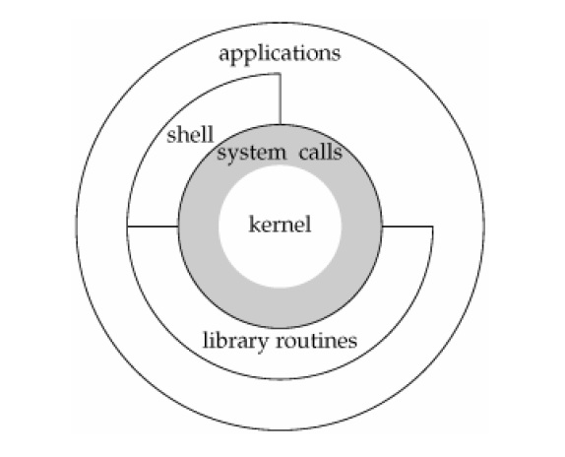
What is a system call?
A process requests a service from the operating-system kernel.
User space
Application code and libraries.
Kernel space
Protected OS code and resources.
The boundary
An approved entry point with
arguments the kernel must validate.
Page · 3
Notes:
A system call is a controlled interface for a user process to request a kernel service. The entry instruction is architecture-specific; software interrupt is one mechanism, not the definition of every syscall.
Adapted from Dr. Si Chen, ss2024 Chapter 6 (original PPTX slides 3).
https://www.cs.wcupa.edu/SCHEN/ss2024/slides/ch06.pptx
https://man7.org/linux/man-pages/man2/syscall.2.html

Slide 4
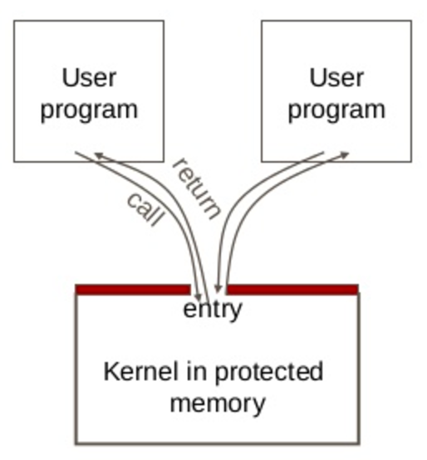
Why a privilege boundary?
Applications can be buggy
User code cannot freely read or
modify protected kernel memory.
The kernel mediates access
Files, processes, networking,
and memory permissions.
Controlled entry and return
The kernel validates requests,
then resumes user execution.
Page · 4
Notes:
Use the original gatekeeper image. A syscall switches execution to kernel code; it does not make arbitrary user code privileged or turn the user into root. Kernel validation and process credentials remain relevant.
Adapted from Dr. Si Chen, ss2024 Chapter 6 (original PPTX slides 4).
https://www.cs.wcupa.edu/SCHEN/ss2024/slides/ch06.pptx
https://man7.org/linux/man-pages/man2/syscall.2.html

Slide 5
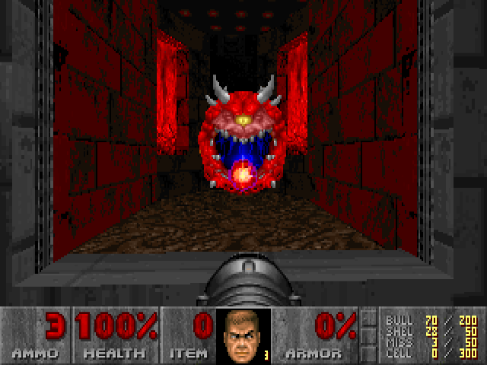
Why ask the OS to wait?
A fragile delay
Loop time is not a clock
for (i = 0; i < N; ++i) {
/* busy wait */
}
CPU speed, optimization, and
other activity change the delay.
Use an OS timer
The thread can sleep while the
CPU runs other work.
Still not exact timing
The scheduler may resume the
thread later than requested.
Page · 5
Notes:
Retains the original busy-loop/timer teaching example. Old 100 MHz vs 1000 MHz timings were illustrative, not measurements. A sleep duration is not a guarantee of an exact wake-up time; scheduling may delay resumption.
Adapted from Dr. Si Chen, ss2024 Chapter 6 (original PPTX slides 5).
https://www.cs.wcupa.edu/SCHEN/ss2024/slides/ch06.pptx
https://man7.org/linux/man-pages/man2/nanosleep.2.html

Slide 6
Linux i386: crossing the boundary
User code
int 0x80
Resume user code
User mode
Kernel mode
IDT entry 0x80
Kernel syscall
dispatch + handler
Conceptual path for int 0x80. Other architectures use different entry mechanisms.
Page · 6
Notes:
Original native CPU-interrupt diagram retained and updated. IDT = Interrupt Descriptor Table in x86 protected mode. The syscall dispatcher uses the syscall number to select the service. Return to user mode restores the user execution context. This is a conceptual control-flow sketch, not a complete kernel entry implementation.
Adapted from Dr. Si Chen, ss2024 Chapter 6 (original PPTX slides 6, 7).
https://www.cs.wcupa.edu/SCHEN/ss2024/slides/ch06.pptx
https://man7.org/linux/man-pages/man2/syscall.2.html

Slide 7
The Linux i386 syscall contract
Role | Linux i386 convention
Entry instruction | int 0x80
System-call number | EAX
Arguments 1–6 | EBX, ECX, EDX, ESI, EDI, EBP
Result | EAX; raw errors are negative errno values
This is the syscall ABI. It is different from a C function’s calling convention.
Page · 7
Notes:
Review the code path before the syscall: EAX selects the operation. Arguments use registers, not the cdecl argument stack. Raw negative errors differ from libc error reporting. We use write=4, exit=1, execve=11 in i386.
Adapted from Dr. Si Chen, ss2024 Chapter 6 (original PPTX slides 17).
https://www.cs.wcupa.edu/SCHEN/ss2024/slides/ch06.pptx
https://man7.org/linux/man-pages/man2/syscall.2.html

Slide 8
32-bit and 64-bit are different ABIs
 | Linux i386 (our demos) | Linux x86-64
Entry | int 0x80 | syscall
Number / result | EAX / EAX | RAX / RAX
First 3 arguments | EBX, ECX, EDX | RDI, RSI, RDX
write / exit / execve | 4 / 1 / 11 | 1 / 60 / 59
Always identify the target ABI before choosing syscall numbers or registers.
Page · 8
Notes:
All executable examples today are 32-bit Linux. On a 64-bit kernel, a supported 32-bit process still uses the i386 ABI. Do not mix syscall numbers, argument registers, pointers, or instructions. x86-64 syscall also clobbers RCX and R11.
Adapted from Dr. Si Chen, ss2024 Chapter 6 (original PPTX slides 6, 17).
https://www.cs.wcupa.edu/SCHEN/ss2024/slides/ch06.pptx
https://man7.org/linux/man-pages/man2/syscall.2.html
https://raw.githubusercontent.com/torvalds/linux/master/arch/x86/entry/syscalls/syscall_32.tbl
https://raw.githubusercontent.com/torvalds/linux/master/arch/x86/entry/syscalls/syscall_64.tbl

Slide 9
Find the numbers for the target ABI
Inside WolfCTF
grep -E "__NR_(write|exit|execve) " \
/usr/include/asm/unistd_32.h
#define __NR_exit 1
#define __NR_write 4
#define __NR_execve 11
The syscall table belongs to an ABI, not to the assembly syntax.
Page · 9
Notes:
Use installed headers, then relate them to the official Linux syscall tables. _exit in libc is not guaranteed to invoke the raw exit syscall; modern glibc normally uses exit_group. These demos call raw i386 exit directly.
Adapted from Dr. Si Chen, ss2024 Chapter 6 (original PPTX slides 10, 11).
https://www.cs.wcupa.edu/SCHEN/ss2024/slides/ch06.pptx
https://man7.org/linux/man-pages/man2/syscall.2.html

Slide 10
Get the classroom code on WolfCTF
Open portal.wolfctf.com/labs/lab1 → launch your terminal
Run these commands in the Linux terminal
cd ~
curl -fLO https://wcu.ninja/files/CSC472_Week04_code.tar.gz
tar -xzf CSC472_Week04_code.tar.gz
cd ~/csc472-week04/class06
make
file helloworld
Expected architecture: ELF 32-bit, Intel 80386. GDB loads GEF automatically.
Page · 10
Notes:
Open the existing Lab 1 environment. The archive unpacks into a separate folder in the home directory. These are lecture demos, not extra Lab 1 submission requirements.
Adapted from Dr. Si Chen, ss2024 Chapter 6 (original PPTX slides 13, 14).
https://www.cs.wcupa.edu/SCHEN/ss2024/slides/ch06.pptx
https://portal.wolfctf.com/labs/lab1

Slide 11
Hello World through write()
helloworld.asm — Linux i386
Data
section .text
global _start, write_call
_start:
mov eax, 4 ; write
mov ebx, 1 ; stdout
mov ecx, msg ; buffer address
mov edx, msg_len ; byte count
write_call:
int 0x80
mov eax, 1 ; exit
xor ebx, ebx
int 0x80
section .data
msg: db 'Hello world!', 10
msg_len equ $ - msg
DB emits bytes.
12 visible characters
+ one newline
= 13 bytes.
Page · 11
Notes:
Adapted directly from the original helloworld.asm. msg_len is assembled from the actual data length to prevent stale hard-coded lengths. Explain $ as the current assembly position. This short demo omits general short-write/error handling.
Adapted from Dr. Si Chen, ss2024 Chapter 6 (original PPTX slides 13).
https://www.cs.wcupa.edu/SCHEN/ss2024/slides/ch06.pptx
https://www.nasm.us/doc/nasm09.html
https://man7.org/linux/man-pages/man2/syscall.2.html

Slide 12
Assemble, link, then observe
The commands behind make
nasm -f elf32 -g -F dwarf helloworld.asm -o helloworld.o
ld -m elf_i386 -z noexecstack helloworld.o -o helloworld
./helloworld
Hello world!
Object file → executable
The linker resolves the address of msg in the separate data section.
What does the kernel receive?
A file descriptor, a pointer, and a count — not a C string.
Page · 12
Notes:
Makefile uses these commands. NASM emits an ELF32 object; ld supplies the final executable layout and resolves symbols. -z noexecstack records that the stack is not executable. The syscall itself does not require an executable stack.
Adapted from Dr. Si Chen, ss2024 Chapter 6 (original PPTX slides 13).
https://www.cs.wcupa.edu/SCHEN/ss2024/slides/ch06.pptx
https://www.nasm.us/doc/nasm09.html
https://sourceware.org/binutils/docs/binutils/objcopy.html

Slide 13
strace: see the kernel requests
Trace our 32-bit executable
strace -e trace=write,exit ./helloworld > /dev/null
write(1, "Hello world!\n", 13) = 13
exit(0) = ?
+++ exited with 0 +++
Read the line as a contract
write(fd = 1, buffer = "Hello world!\n", count = 13) returns 13.
A useful distinction
strace shows kernel calls; it does not list every C library call.
Page · 13
Notes:
Unlike tracing an arbitrary /bin/echo binary that may be 64-bit, trace the 32-bit hello program we built. Addresses and process IDs vary; the write and exit calls are the relevant evidence.
Adapted from Dr. Si Chen, ss2024 Chapter 6 (original PPTX slides 12).
https://www.cs.wcupa.edu/SCHEN/ss2024/slides/ch06.pptx
https://man7.org/linux/man-pages/man2/syscall.2.html

Slide 14
GEF: inspect the syscall registers
gdb -q ./helloworld
gef config context.layout 'regs code stack'
break write_call
run
info registers eax ebx ecx edx
x/13cb $ecx
si
print/d $eax
Before int 0x80: 4, 1, buffer address, 13. After this successful write: EAX = 13.
Page · 14
Notes:
Break on write_call before int 0x80. Expected EAX=4 EBX=1 EDX=13 and ECX points to the message. si observes the return from the syscall; userspace GDB does not step through the kernel. If the program has exited, run again to inspect registers.
Adapted from Dr. Si Chen, ss2024 Chapter 6 (original PPTX slides 13, 17).
https://www.cs.wcupa.edu/SCHEN/ss2024/slides/ch06.pptx
https://hugsy.github.io/gef/

Slide 15
execve(): replace the current program
The syscall setup
mov eax, 11 ; execve
mov ebx, sh ; pathname
mov ecx, argv ; argument-vector pointer
mov edx, envp ; environment-vector pointer
int 0x80
Data in shell.asm
DD emits 32-bit values.
argv holds pointers.
DB emits the pathname bytes.
argv: dd sh, 0
envp: dd 0
sh: db '/bin/sh', 0
Page · 15
Notes:
Adapted from shell.asm. Success replaces the process image and does not return; it does not create a new PID by itself. argv must be a NULL-terminated array of pointers. We supply a NULL-terminated empty envp array instead of relying on Linux-specific acceptance of a NULL envp pointer.
Adapted from Dr. Si Chen, ss2024 Chapter 6 (original PPTX slides 14).
https://www.cs.wcupa.edu/SCHEN/ss2024/slides/ch06.pptx
https://man7.org/linux/man-pages/man2/execve.2.html

Slide 16
Running the shell example
Success
In the WolfCTF terminal
/bin/sh becomes the current
process image.
./shell
id
exit
Failure
execve returns a negative
error code in raw EAX.
Address dependence
This ELF uses absolute addresses
for data — revisit on Thursday.
Type exit to return from the demonstration shell to your lab terminal.
Page · 16
Notes:
The supplied shell.asm has an exit(1) fallback after a failed execve. Keep demonstrations inside the student’s own lab environment. No remote target is involved.
Adapted from Dr. Si Chen, ss2024 Chapter 6 (original PPTX slides 14).
https://www.cs.wcupa.edu/SCHEN/ss2024/slides/ch06.pptx
https://man7.org/linux/man-pages/man2/execve.2.html

Slide 17
Useful calls and memory permissions
Service | What the process asks the kernel to do
open / read / write | Open a file; transfer bytes through a file descriptor.
mmap | Create a mapping in the process address space.
mprotect | Change access permissions of a page-aligned range.
execve | Replace the current process image with a program.
Read, write, and execute are distinct permissions. Changing one mapping is local.
Page · 17
Notes:
Corrects the old shorthand “mprotect: disable DEP.” mprotect changes permissions of pages belonging to this process, subject to policy. It does not globally disable NX, change other processes, or guarantee a hardened policy permits executable mappings.
Adapted from Dr. Si Chen, ss2024 Chapter 6 (original PPTX slides 15).
https://www.cs.wcupa.edu/SCHEN/ss2024/slides/ch06.pptx
https://man7.org/linux/man-pages/man2/mprotect.2.html
https://man7.org/linux/man-pages/man2/mmap.2.html
https://man7.org/linux/man-pages/man2/execve.2.html

Slide 18
Library calls are another layer
fwrite() → buffering → write() as needed
Many library writes can become one kernel write. A flush may trigger I/O.
malloc() → allocator → mapping calls as needed
An allocation can reuse memory already owned by the process.
Error reporting
Raw syscall: negative error value. Typical libc wrapper: −1 and errno.
Interface choice
Libc provides a convenient API; raw syscalls expose the ABI directly.
Page · 18
Notes:
Retains ss2024 libc-wraps-syscalls concept while correcting one-to-one mappings. fwrite uses buffering; malloc often satisfies requests from existing allocator memory. A library function is not necessarily a syscall wrapper. Raw kernel errors and libc errno differ.
Adapted from Dr. Si Chen, ss2024 Chapter 6 (original PPTX slides 9, 16).
https://www.cs.wcupa.edu/SCHEN/ss2024/slides/ch06.pptx
https://man7.org/linux/man-pages/man3/stdio.3.html
https://man7.org/linux/man-pages/man3/malloc.3.html
https://man7.org/linux/man-pages/man2/syscall.2.html

Slide 19
Practice: predict before stepping
1 · Predict
What changes if the Hello World byte count is 5 instead of 13?
2 · Test
Change only EDX’s count, rebuild, and inspect it at write_call.
3 · Explain
Why does write() not need a terminating NUL byte?
4 · Connect
Which registers belong to the syscall ABI, and which hold addresses?
Page · 19
Notes:
Allow 8–10 minutes. First ask students to predict output and EAX after write. Change mov edx,msg_len to mov edx,5. Rebuild and inspect. Expected output is Hello without a newline; EAX=5 if all five bytes are written. No new graded submission.
Adapted from Dr. Si Chen, ss2024 Chapter 6 (original PPTX slides 13, 17).
https://www.cs.wcupa.edu/SCHEN/ss2024/slides/ch06.pptx

Slide 20
Next: turn the program into bytes
Today’s checkpoint
Identify the ABI → load registers → enter kernel → inspect the result.
Thursday, September 17
Shellcode, position-independent data, and GEF tracing of raw bytes.
Lab 1 continues on WolfCTF
Due Thursday, September 24, 2026 · 11:59 PM Eastern Time.
Submit the required PDF report
D2L → CSC 472 → Assignments → Lab 1
Report guide: wcu.ninja/csc472/lab-report
Page · 20
Notes:
Closing check: require students to distinguish EAX operation vs return value, ECX buffer pointer vs contents, C calling convention vs syscall ABI. Thursday uses the original jump-call-pop hello.asm and updated runner.
Adapted from Dr. Si Chen, ss2024 Chapter 6 (original PPTX slides 17, 18).
https://www.cs.wcupa.edu/SCHEN/ss2024/slides/ch06.pptx

Slide 21
References and classroom files
Original course materials
cs.wcupa.edu/SCHEN/ss2024/ → Chapter 6
Linux interfaces
man7.org: syscall(2), execve(2), mmap(2), mprotect(2)
Assembly and object tools
nasm.us/doc/ · sourceware.org/binutils/docs/
This week’s slides and code
wcu.ninja/csc472/
Code bundle: CSC472_Week04_code.tar.gz
Page · 21
Notes:
All diagrams and historical examples are adapted from the instructor’s original ss2024 Chapter 6. Technical corrections verified against the primary references listed in slide notes. Revised September 11, 2026.
Adapted from Dr. Si Chen, ss2024 Chapter 6 (original PPTX slides 1, 3, 4, 5, 7, 13, 14, 16, 17).
https://www.cs.wcupa.edu/SCHEN/ss2024/slides/ch06.pptx

