Slide 1

Class12
CSC 472 Software Security
ROP (3) & Dynamic Linking
& Return-to-libc Attack
Dr. Si Chen (schen@wcupa.edu)

Slide 2
Review

Slide 3
Return-oriented programming
(ROP)

Slide 4
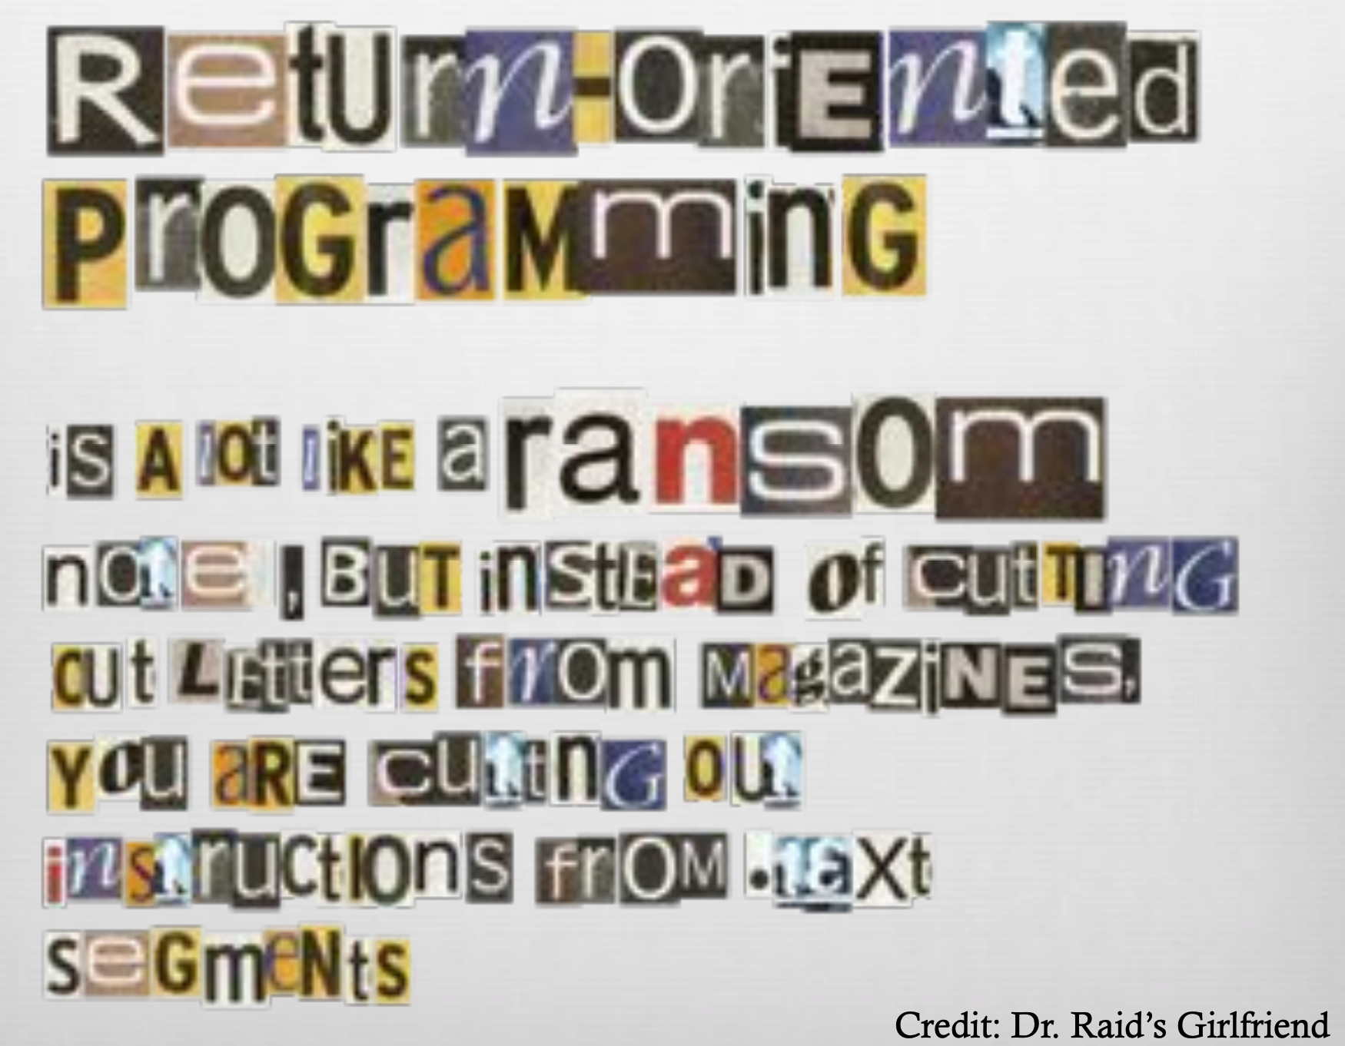

Slide 5
ROP: The Main Idea

Slide 6
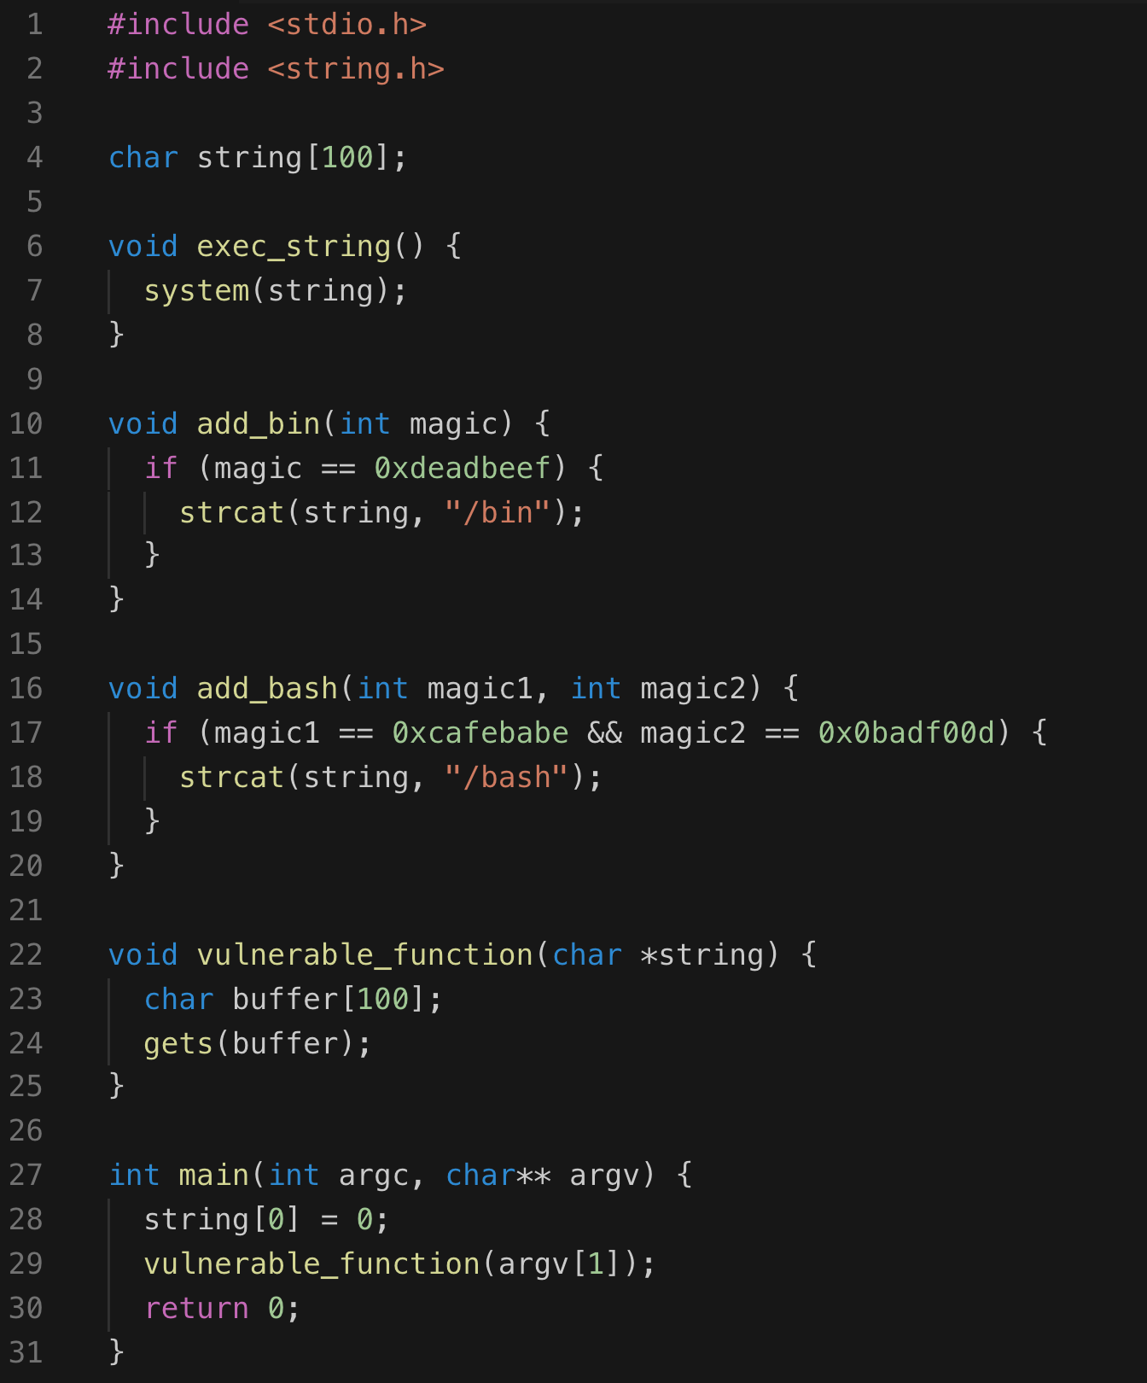
x
Execution Path
add_bin()
  magic == 0xdeadbeef
add_bash()
  magic1 == 0xcafebabe
  magic2 == 0x0badf00d
exec_string()
Spawn shell

Slide 7
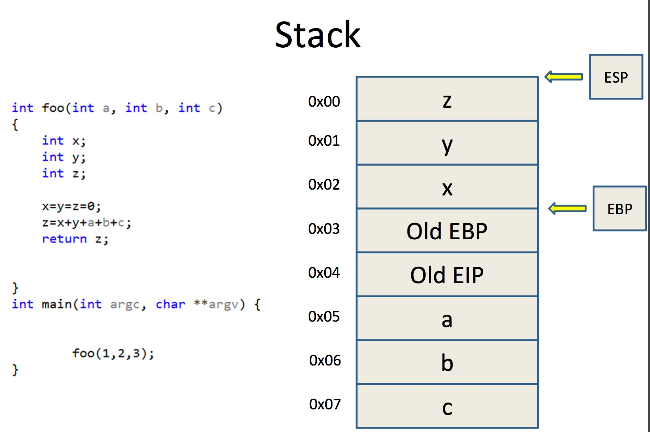
Return Chaining
First Function Address
Next Function Address
Arguments1 for First Function
Arguments2 for First Function …

Slide 8
Return Chaining
Execution Path
The previous ROP chain does not work, because argument
0xdeadbeef is still on the stack, we need to find a way to ”clean” it
add_bin()
  magic == 0xdeadbeef
add_bash()
  magic1 == 0xcafebabe
  magic2 == 0x0badf00d
exec_string()
Spawn shell
Add_bin()
Add_bash()
Exec_string()
  magic == 0xdeadbeef
Solution: use a pop, ret gadget to push the argument 0xdeadbeef into a register to remove it from the stack
Dummy Character “A”s
Address for Add_bin()
Address for pop_ret
0xdeadbeef
Address for Add_bash()

Slide 9
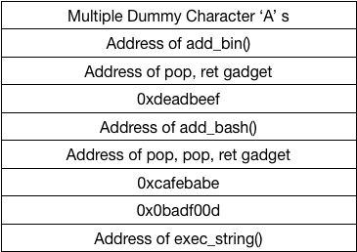

Slide 10
ELF (Executable Linkable Format)

Slide 11
ELF executable for Linux
Executable and Linkable Format (ELF)
Linux | Windows
ELF file | .exe (PE)
.so (Shared object file) | .dll (Dynamic Linking Library)
.a | .lib (static linking library)
.o (intermediate file between complication and linking, object file) | .obj

Slide 12
ELF executable for Linux
ELF32-bit LSB
Dynamically linked

Slide 13
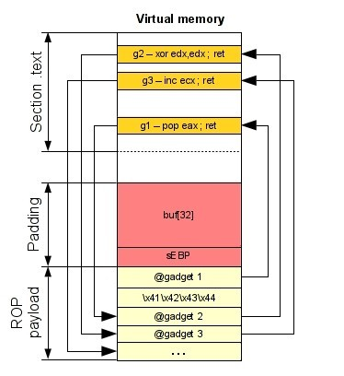
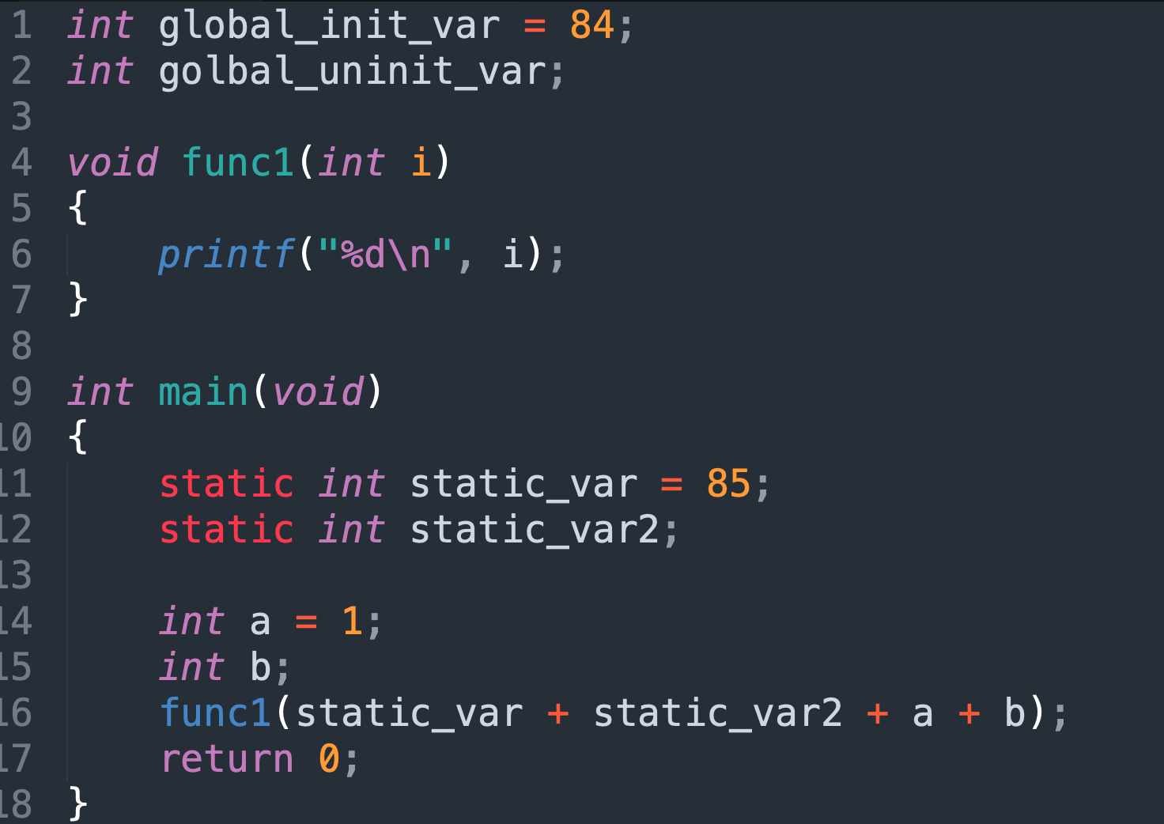
Section (or Segment) in ELF
ELF file /
Object file
File Header
.text section
.data section
.bss (Block started by symbol) section
Notes:
UASAP (United Aircraft Symbolic Assembly Program) → IBM 704

Slide 14
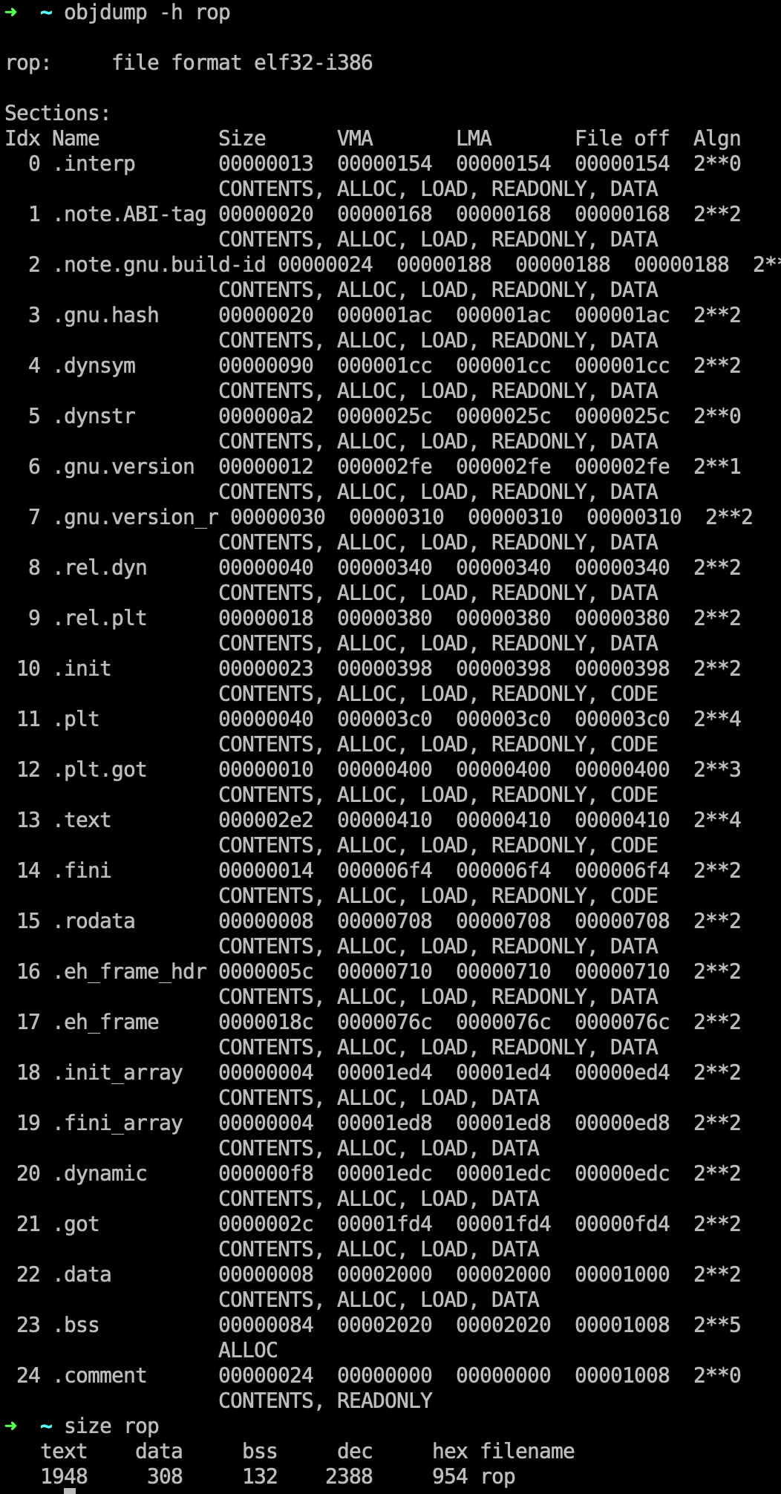
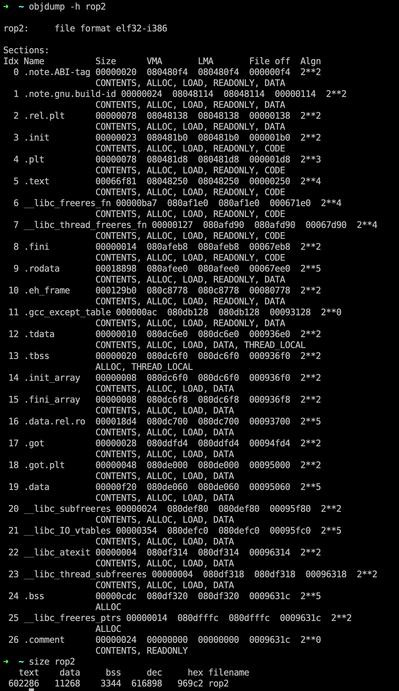

Slide 15
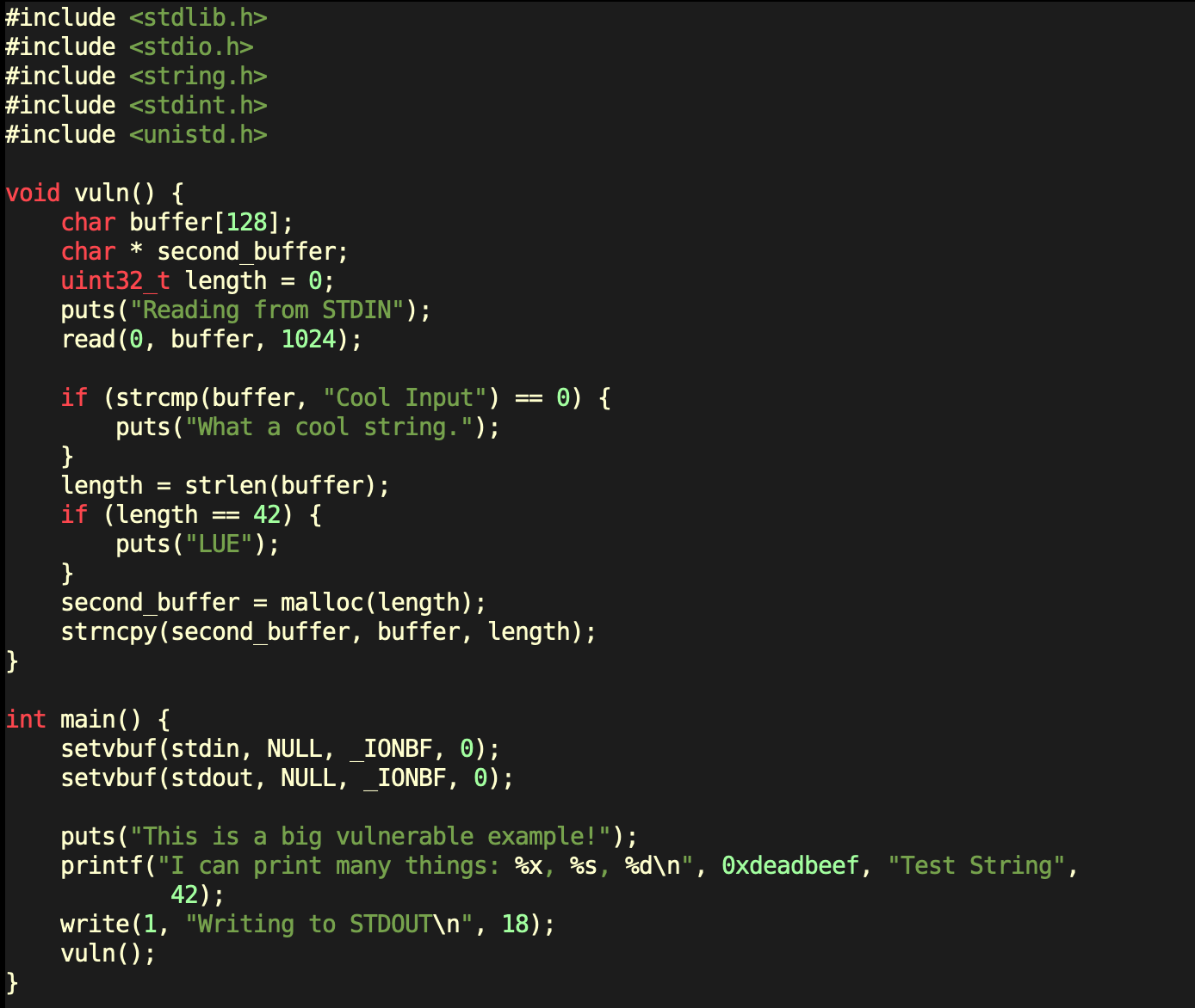
rop2.c
Since the binary is not big enough to give us a decent number of ROP gadgets, we will cheat a bit and compile the binary as a statically linked ELF.
This should include library code in the final executable and bulk up the size of the binary.

Slide 16
Linux System Call
f we take a look at the syscall reference, we can see that some parameters are expected in the eax, ebx, ecx, and edx registers.
  eax - holds the number of the syscall to be called
  ebx - a pointer to the string containing the file name to be executed
  ecx - a pointer to the array of string pointers representing argv
  edx - a pointer to the array of string pointers representing envp
For our purposes, the value that each of the registers should contain are:
  eax = 0xb
  ebx = "/bin/sh"
  ecx = memory address -> 0
  edx = memory address -> 0

Slide 17
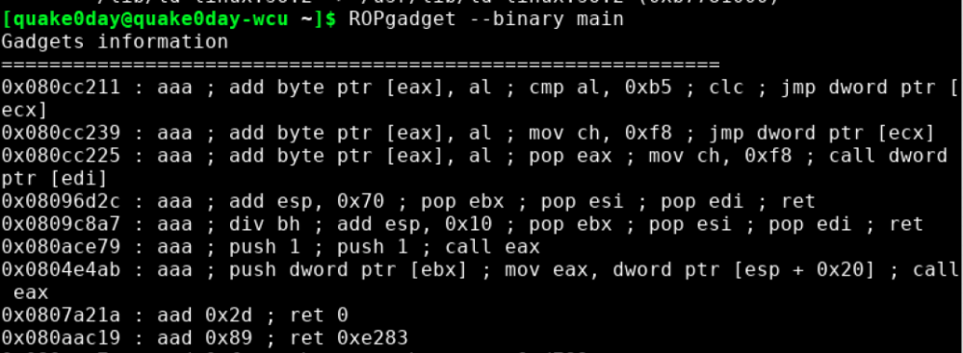
ROPgadget

Slide 18
Dynamic Linking

Slide 19
rop2.c
Since the binary is not big enough to give us a decent number of ROP gadgets, we will cheat a bit and compile the binary as a statically linked ELF.
This should include library code in the final executable and bulk up the size of the binary.

Slide 20
Drawbacks of Static Linking
Memory
Waste space
Hard to maintain
Program2
Program2.o
Lib.o
Program1
Program1.o
Lib.o
Program2
Program2.o
Lib.o
Program1
Program1.o
Lib.o

Slide 21
Dynamic Linking
Memory
Lib.so
Lib.o
Program2
Program2.o
Program1
Program1.o
Program2
Program2.o
Lib.so
Lib.o
Program1
Program1.o

Slide 22
Dynamic Linking in Linux and Windows
Linux | Windows
ELF file | .exe (PE)
.so (Shared object file) | .dll (Dynamic Linking Library)
.a | .lib (static linking library)
.o (intermediate file between complication and linking, object file) | .obj

Slide 23
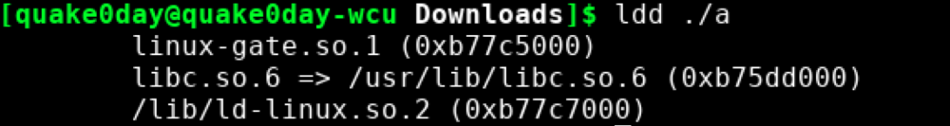
Shared library
ELF is loaded by ld-linux.so.2 → in charge of memory mapping, load shared library etc..
You can call functions in libc.so.6

Slide 24
Return-Oriented Programming (ROP)
What happens if the binary we have to attack is not large enough to provide us the gadgets we need?

Slide 25
ret2libc Attack

Slide 26
Introduction
“Getting around non-executable stack (and fix)”, Solar Designer (BUGTRAQ, August 1997)
https://seclists.org/bugtraq/1997/Aug/63
The ret2libc and return oriented programming (ROP) technique relies on overwriting the stack to create a new stack frame that calls the system function.

Slide 27
ret2libc Attack
We were able to pick from a wealth of ROP gadgets to construct the ROP chain in the previous section because the binary was huge.
Now, what happens if the binary we have to attack is not large enough to provide us the gadgets we need?
One possible solution, since ASLR is disabled, would be to search for our gadgets in the shared libraries loaded by the program such as libc.
However, if we had these addresses into libc, we could simplify our exploit to reuse useful functions. One such useful function could be the system() function.

Slide 28
libc
C standard library
Provides functionality for string handling, mathematical computations, input/output processing, memory management, and several other operating system services
  <stdio.h>
  <stdlib.h>
  <string.h>
However, if we had these addresses into libc, we could simplify our exploit to reuse useful functions. One such useful function could be the system() function.
→ find System() function’s address

Slide 29
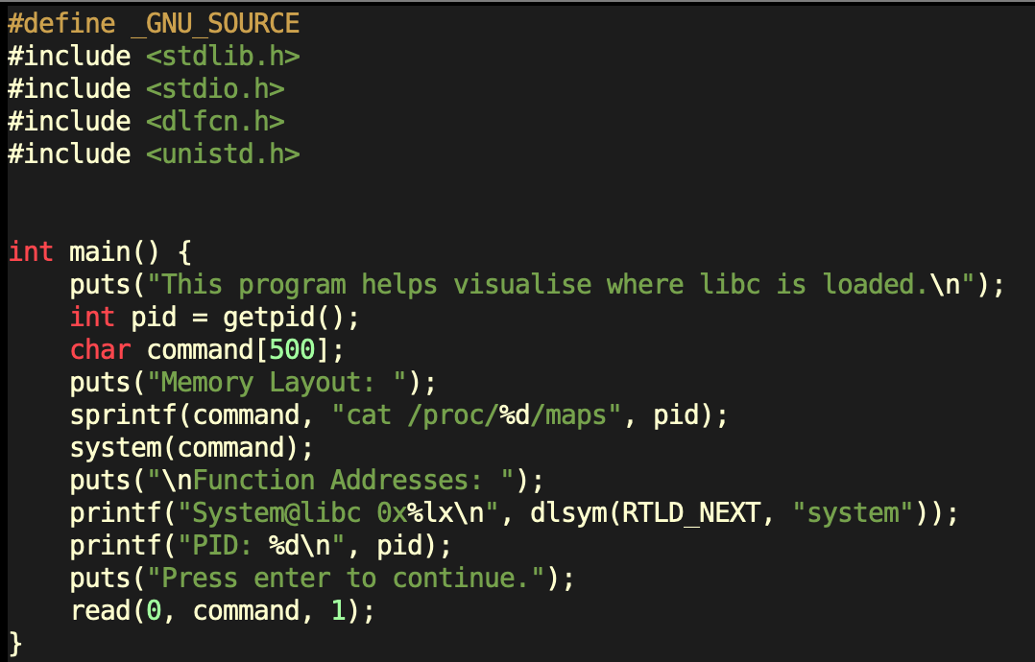
reveal_address.c

Slide 30
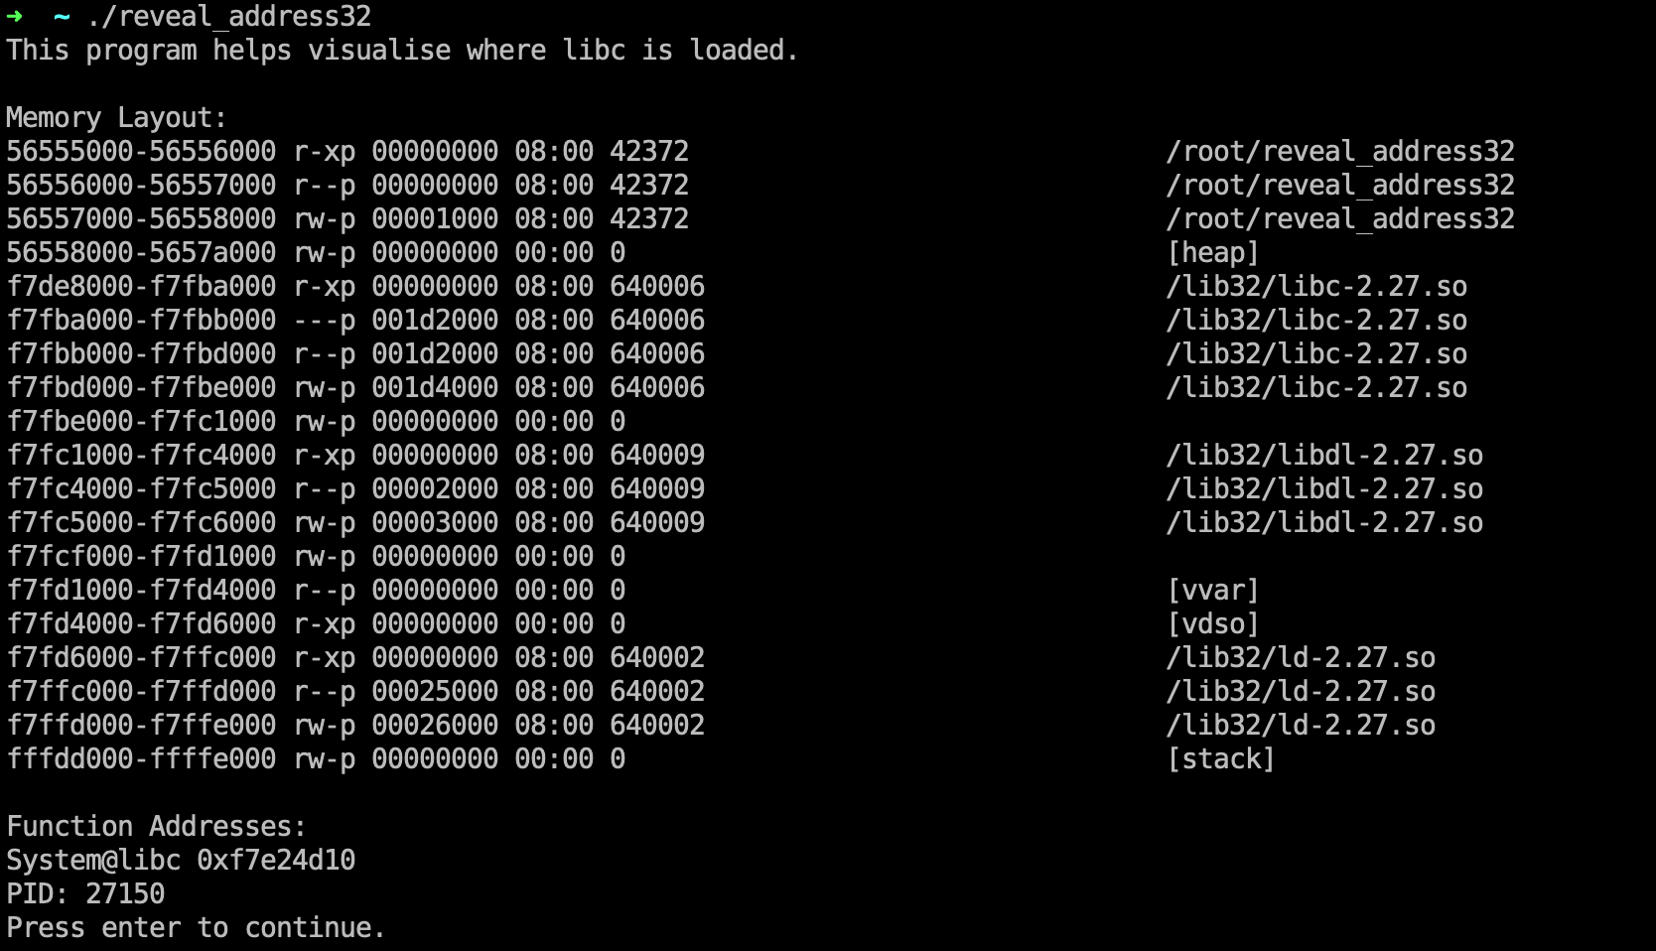
reveal_address 32 bit version
Memory
/lib32/libc-2.27.so
/lib32/libc-2.27.so

Slide 31
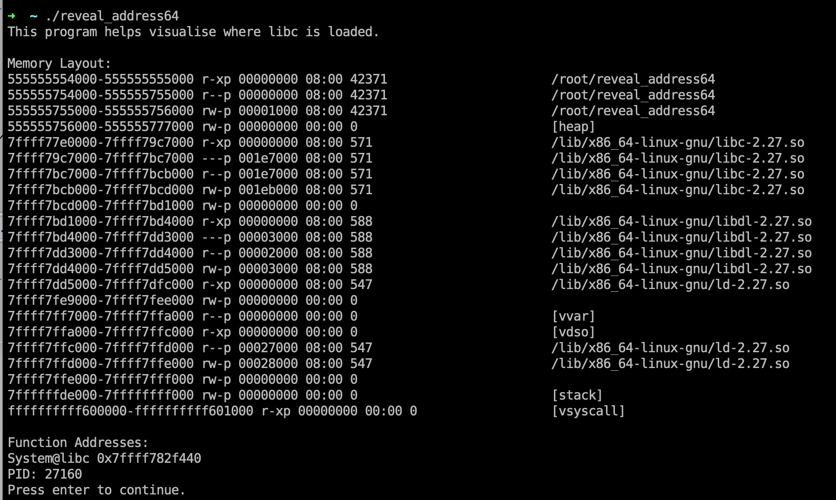
reveal_address 64 bit version
Memory
/lib/x86_64-linux-gnu/libc-2.27.so
/lib/x86_64-linux-gnu/libc-2.27.so

Slide 32
Ret2lib Shellcode Structure
Function Address
Return Address (Old EIP)
Arguments
Dummy Characters
Address for System() in libc
Address for Exit() function in libc (if you want to exit the program gracefully)
Address for Command String (“e.g. /bin/sh”)

Slide 33
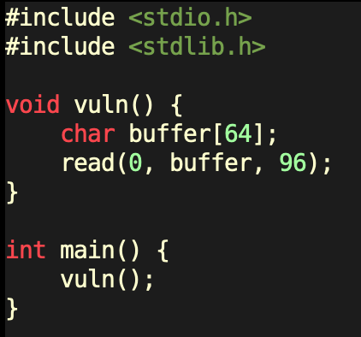
ret2lib.c
Dummy Characters
Address for System() in libc
Address for Exit() function in libc (if you want to exit the program gracefully)
Address for Command String (“e.g. /bin/sh”)

Slide 34
Hands-on: ret2libc on WolfCTF
Open the demo in your browser terminal — GDB + GEF ready, no setup.
ret2lib.c is pre-built with NX on (no execstack) and -no-pie.
Walk the exploit end to end:
  find the 76-byte offset to the saved return address (cyclic pattern),
  locate system(), exit() and "/bin/sh" in the process’s own loaded libc,
  forge the call frame [ &system ][ &exit ][ &"/bin/sh" ] and pop a shell.
Demo: portal.wolfctf.com/labs/csc472-ret2libc-demo

Slide 35

ASLR in Depth
(not really…)

Slide 36
Shutdown ASLR
Shutdown ASLR (Address space layout randomization)

Slide 37
Address Space Layout Randomization (ASLR)
Address Space Layout Randomization (ASLR) is a technology used to help prevent shellcode from being successful.
It does this by randomly offsetting the location of modules and certain in-memory structures.

Slide 38
ASLR in Practice — what moves, what doesn’t
Randomized every run: the stack, the heap, the mmap region, and shared libraries (libc).
A no-PIE executable is NOT randomized: its code, PLT and GOT stay at fixed addresses.
32-bit libc has low entropy (only a handful of random bits) — even brute-forceable; 64-bit is far stronger.
Lesson: hard-coded libc addresses break under ASLR — but fixed in-binary addresses (PLT/GOT) still work.

Slide 39
Defeating ASLR — leak, rebase, pwn
You cannot guess libc’s base, so leak one real libc address at runtime.
e.g. call puts(puts@GOT) to print puts’s resolved runtime address.
libc_base = leaked_addr − offset(puts); then system / "/bin/sh" = libc_base + their offsets.
Now the classic ret2libc frame works even with ASLR ON.
Next class: ret2plt / ret2got reuse the binary’s OWN fixed PLT/GOT — no libc leak needed.

Slide 40
Glossary of Terms
ASLR (Address Space Layout Randomization): Security measure in modern OSes to randomize stack and libc addresses on each program execution.
Binary: A binary is the output file from compiling a C or C++ file. Anything in the binary has a constant address.
Canary: A canary is some (usually random) value that is used to verify that nothing has been overrwritten. Programs may place canaries in memory, and check that they still have the exact same value after running potentially dangerous code, verifying the integrity of that memory.
NX (Non-Executable): Security measure in modern OSes to separate processor instructions (code) and data (everything that's not code.) This prevents memory from being both executable and writable.
ROP (Return Oriented Programming): Reusing tiny bits of code throughout the binary to construct commands we want to execute.
Stack: The stack is part of the memory for a binary. Local variables and pointers are often stored here. The stack can be randomized.
libc: A binary is dynamically linked and has a libc file. This means that the whole set of standard library functions are located somewhere in the memory used by the program.

Slide 41
Q & A

