Slide 1


Class13
CSC 472 Software Security
PLT, GOT & Return-to-plt Attack
Dr. Si Chen (schen@wcupa.edu)

Slide 2
Review

Slide 3
Glossary of Terms
Binary: A binary is the output file generated after compiling a C or C++ program. The contents of the binary, such as functions and data, are loaded into memory with fixed addresses during execution.
Stack: The stack is a section of memory allocated for a program's execution, typically used for storing local variables and function call information. While the stack is traditionally static, modern operating systems can randomize its location in memory to enhance security.
NX (Non-Executable): A security feature in modern operating systems that enforces the separation of executable code and non-executable data. This prevents portions of memory that store data from being executed as code, mitigating certain types of attacks.
ROP (Return-Oriented Programming): A technique that exploits existing code fragments (called "gadgets") within a binary to execute arbitrary commands, bypassing security mechanisms that prevent code injection.

Slide 4
Glossary of Terms
libc: In dynamically linked binaries, the C standard library (libc) is not compiled directly into the binary. Instead, the program references a shared libc file loaded into memory at runtime, which contains implementations of standard functions like printf and malloc.
ASLR (Address Space Layout Randomization): A security mechanism in modern operating systems that randomizes the memory addresses of key components, including the stack and libraries like libC, each time a program is executed. This makes it more difficult for attackers to predict the location of exploitable code.

Slide 5
Review
Return-oriented programming
(ROP)

Slide 6
ROP: The Main Idea

Slide 7
Review
ret2libc Attack

Slide 8
libc
C standard library
Provides functionality for string handling, mathematical computations, input/output processing, memory management, and several other operating system services
  <stdio.h>
  <stdlib.h>
  <string.h>
By obtaining these addresses in libc, we can simplify the exploit by reusing existing functions. One particularly useful function is system().
→ Locate the address of the system() function.

Slide 9
Ret2lib Shellcode Structure
Function Address
Return Address (Old EIP)
Arguments
Dummy Characters
Address for System() in libc
Address for Exit() function in libc (if you want to exit the program gracefully)
Address for Command String (“e.g. /bin/sh”)

Slide 10
Shutdown ASLR
Shutdown ASLR (Address space layout randomization)

Slide 11
Address Space Layout Randomization (ASLR)
Address Space Layout Randomization (ASLR) is a technology used to help prevent shellcode from being successful.
It does this by randomly offsetting the location of modules and certain in-memory structures.

Slide 12
PLT, GOT & Return-to-plt Attack

Slide 13
Bypassing ASLR/NX with Ret2PLT

Slide 14
How to bypass ASLR/NX?
When ASLR has been enabled, we no longer can be sure where the libc will be mapped at.
However, that begs the question: how does the binary know where the address of anything is now that they are randomized?
The answer lies in something called the Global Offset Table (GOT) and the Procedure Linkage Table (PLT).

Slide 15
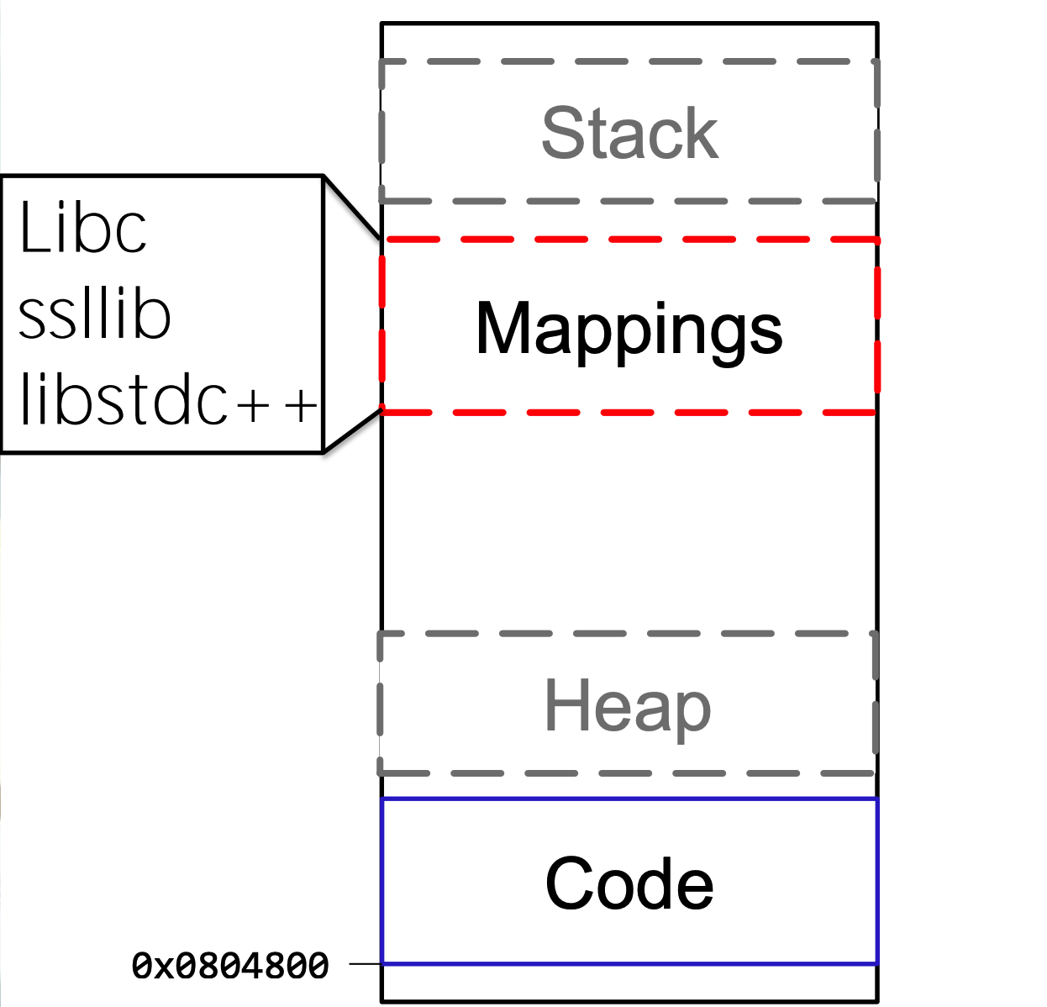
Call Function(s) in libc

Slide 16
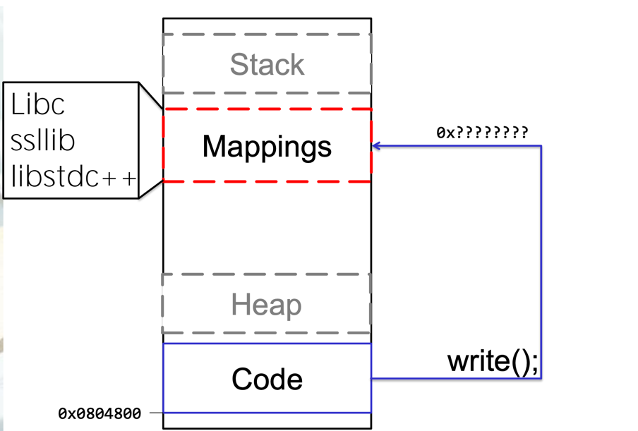
Call Function(s) in libc

Slide 17
ASM CALL
Call’s in ASM are ALWAYS to absolute address
How does it work with dynamic addresses for shared libraries?
Solution:
A “helper” at static location
In Linux: the Global Offset Table (GOT) and the Procedure Linkage Table (PLT).(they work together in tandem)

Slide 18
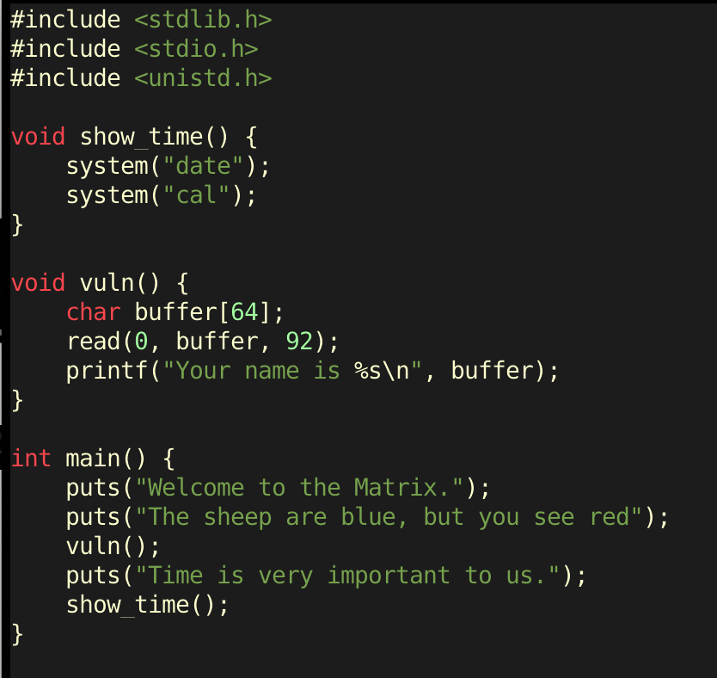
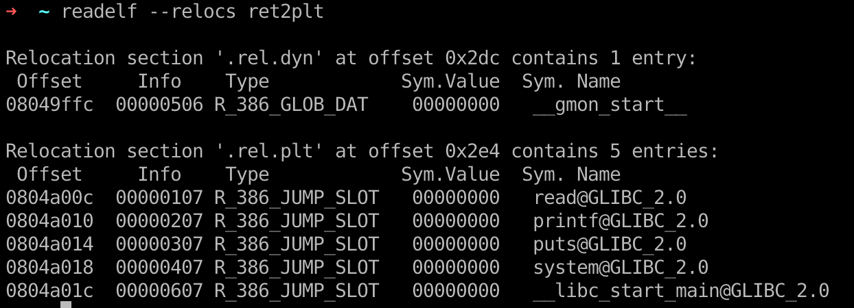
Global Offset Table
To handle functions from dynamically loaded objects, the compiler assigns a space to store a list of pointers in the binary.
Each slot of the pointers to be filled in is called a 'relocation' entry.
This region of memory is marked readable to allow for the values for the entries to change during runtime.
We can take a look at the '.got' segment of the binary with readelf.
ret2plt.c
gcc ret2plt.c -m32 -o ret2plt -no-pie -fno-stack-protector

Slide 19

Global Offset Table
Let's take the read entry in the GOT as an example. If we hop onto gdb, and open the binary in the debugger without running it, we can examine what is in the GOT initially.
0x08048346: An address within the Procedure Linkage Table (PLT)

Slide 20

Global Offset Table
If we run it and break just before the program ends, we can see that the value in the GOT is completely different and now points somewhere in libc.

Slide 21
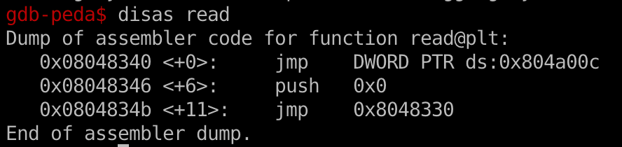
Procedure Linkage Table (PLT)
When you use a libc function in your code, the compiler does not directly call that function but calls a PLT stub instead.
Let's take a look at the disassembly of the read function in PLT.
Here's what's going on here when the function is run for the first time:
The read@plt function is called.
Execution reaches the jmp instruction at address 0x804a00c, and it jumps to the memory address stored there. This address is the GOT entry for the read function.
Initially, the GOT contains the address 0x08048346, so the program continues executing the next instruction in read@plt.
The dynamic loader then updates the GOT with the actual address of the read function.
Finally, execution proceeds with the resolved address.

Slide 22
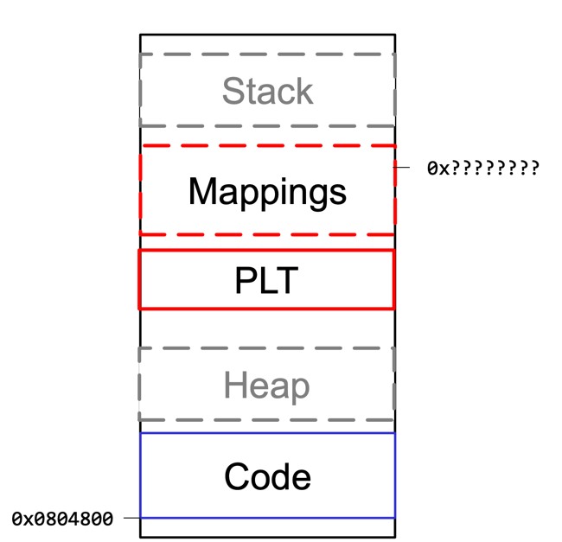
Procedure Linkage Table (PLT)

Slide 23
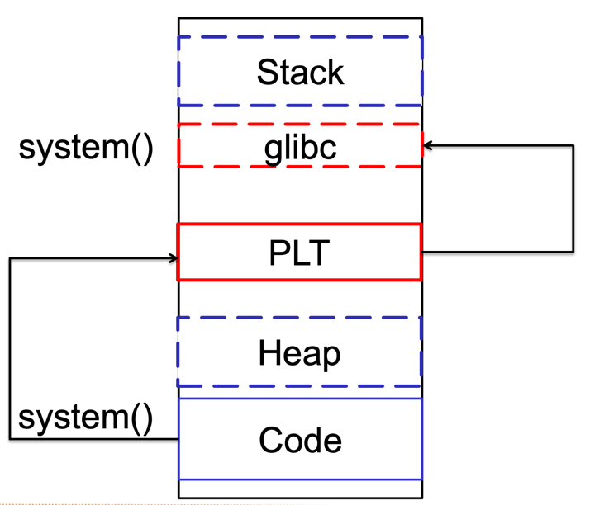
Procedure Linkage Table (PLT)
How does it work?
Call system is actually a call to system@plt.
The PLT resolves system@libc at runtime.
The PLT stores the resolved address of system@libc in system@got.

Slide 24
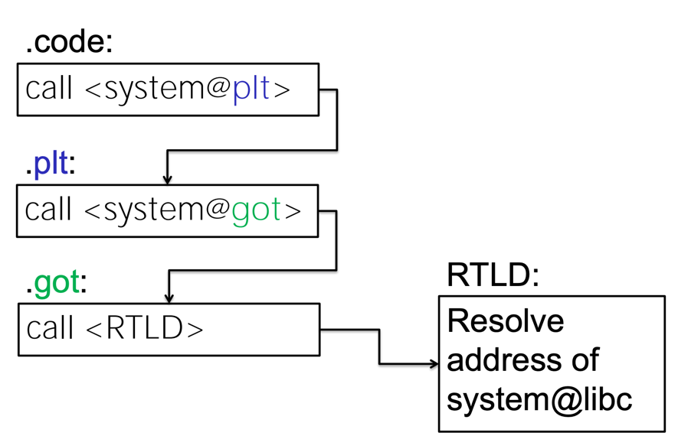
Call System() Function in libc with PLT, GOT

Slide 25
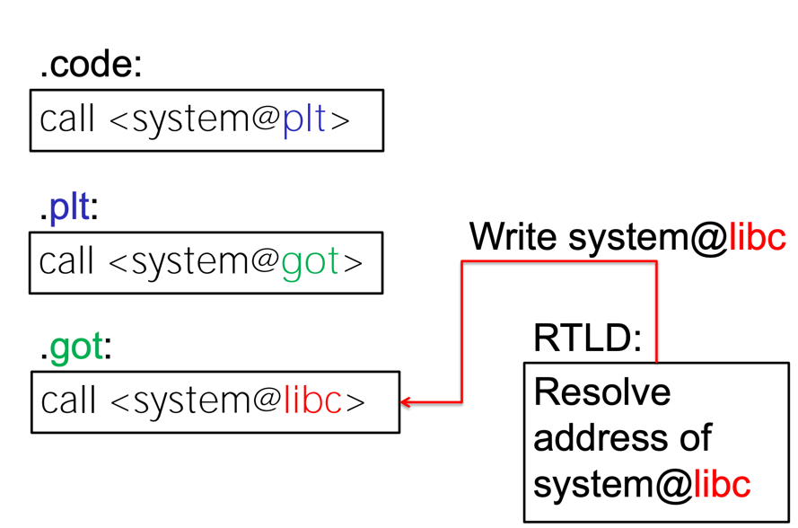
Call System() Function in libc with PLT, GOT

Slide 26
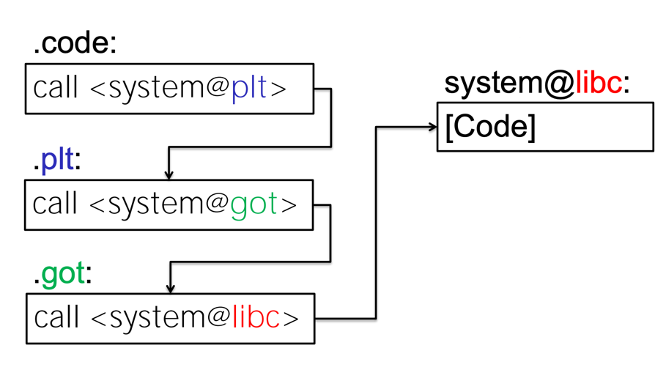
Call System() Function in libc with PLT, GOT

Slide 27

Lazy Binding
First time calling system()
After the first system() call
system@libc

Slide 28
Bypass ASLR/NX with Ret2plt Attack
Enable ASLR (Address space layout randomization)
ret2plt.c

Slide 29
Bypass ASLR/NX with Ret2plt Attack
ret2plt.c
PIE | Position independent executable

Slide 30
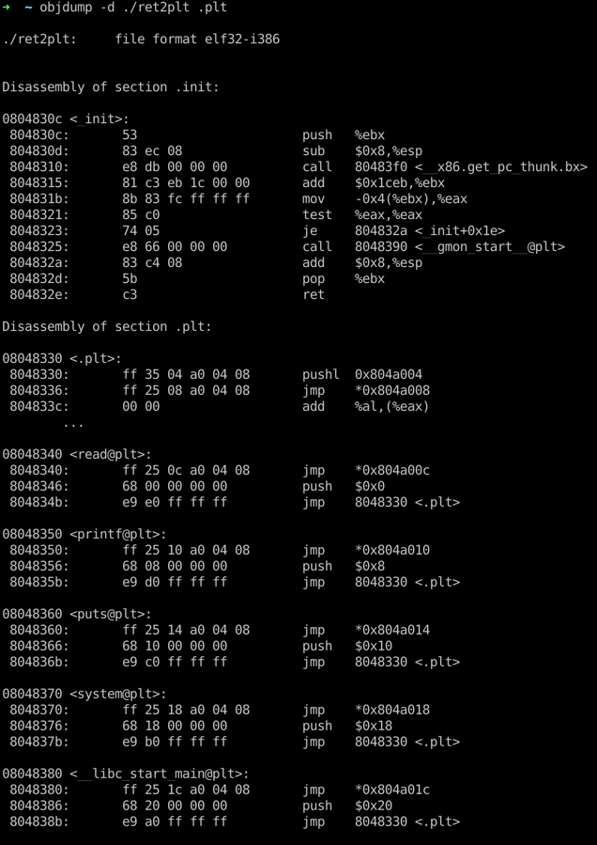
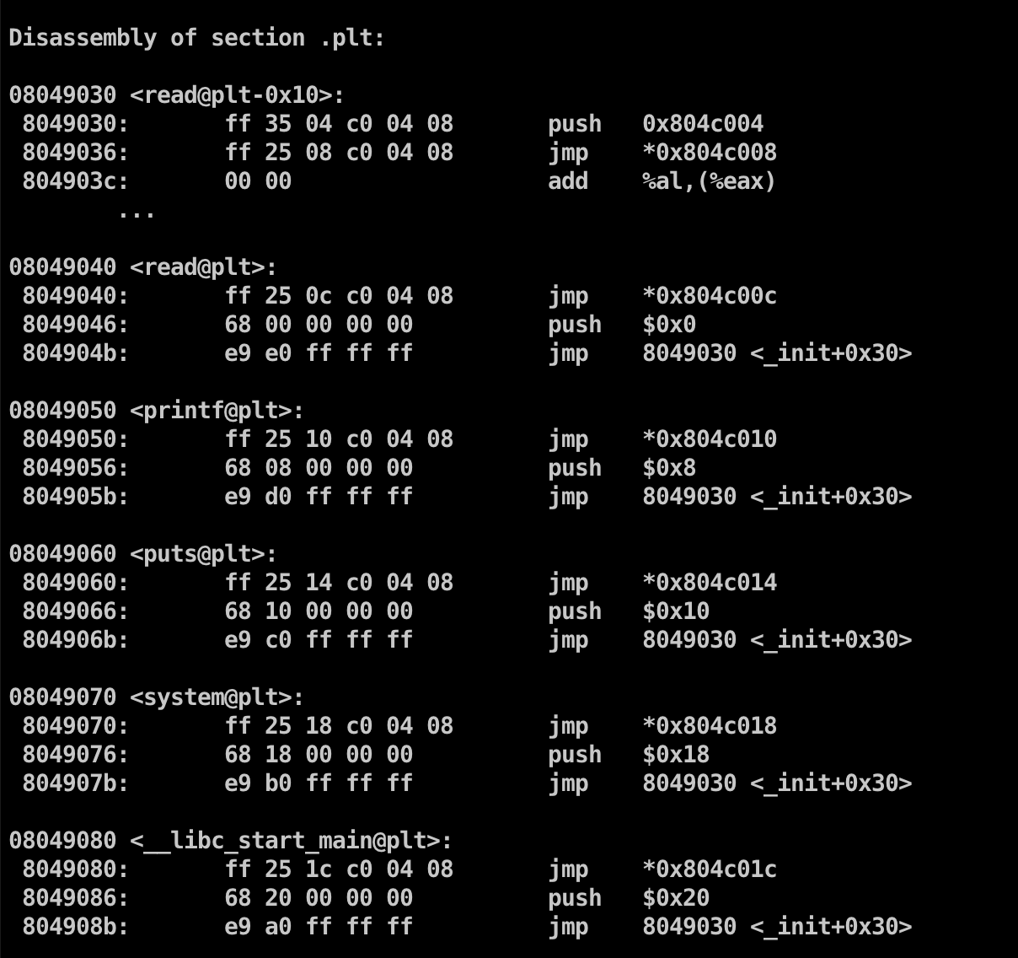
Check PLT stub Address
0x08049070
For system@plt

Slide 31
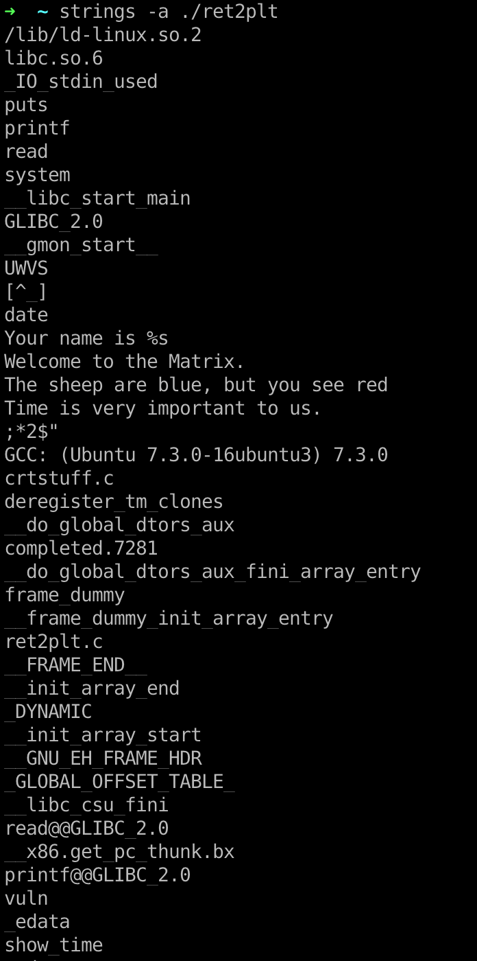
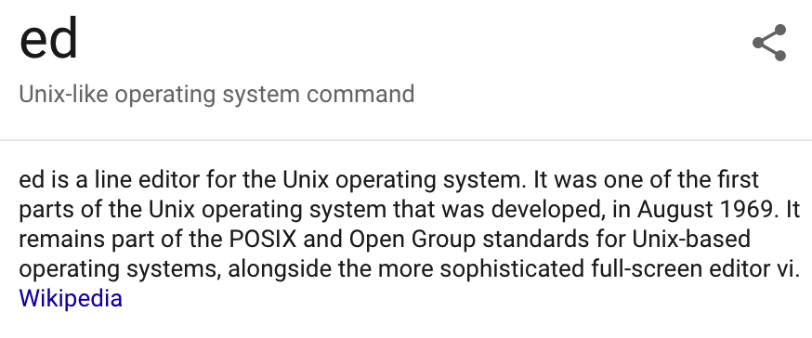
Find Useable String as Parameter for System() function
The sheep are blue, but you see red

Slide 32
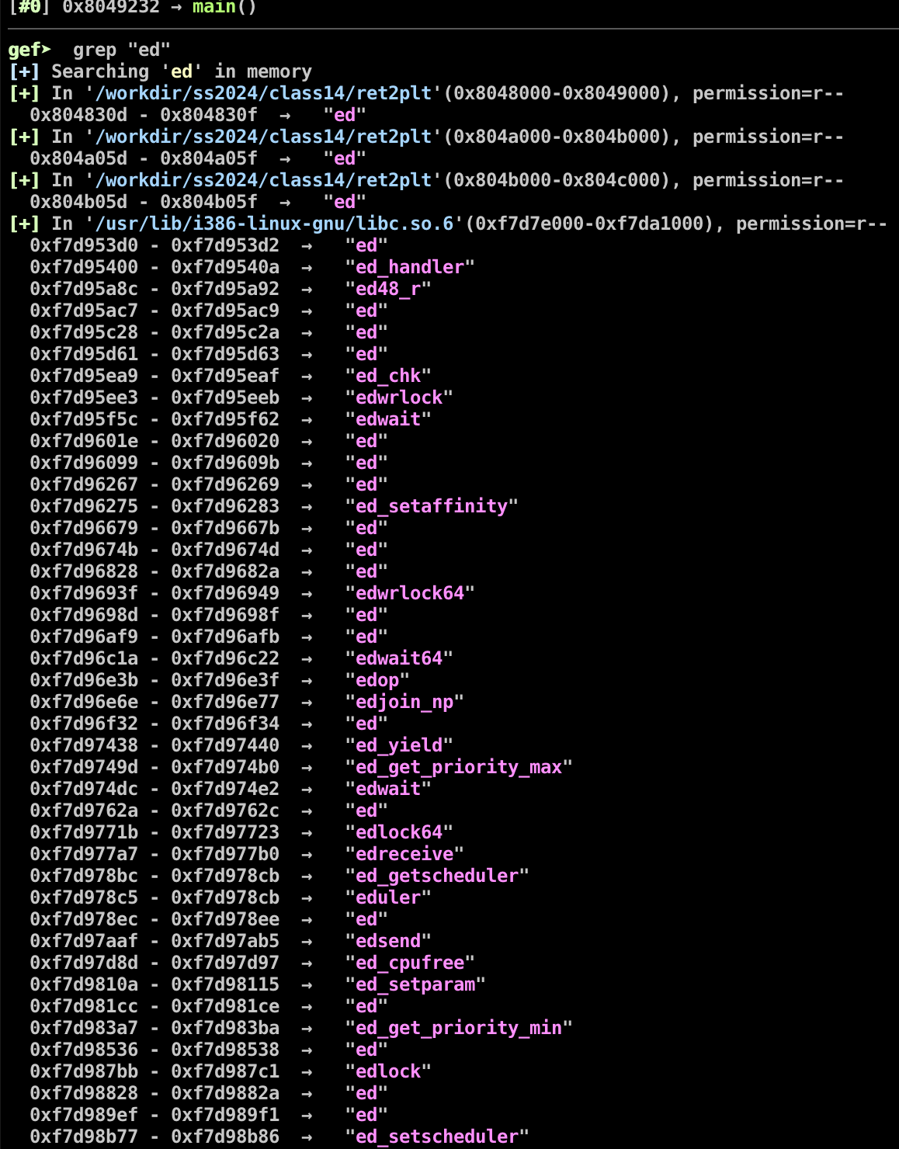
Find Useable String as Parameter for System() function
The sheep are blue, but you see red

Slide 33
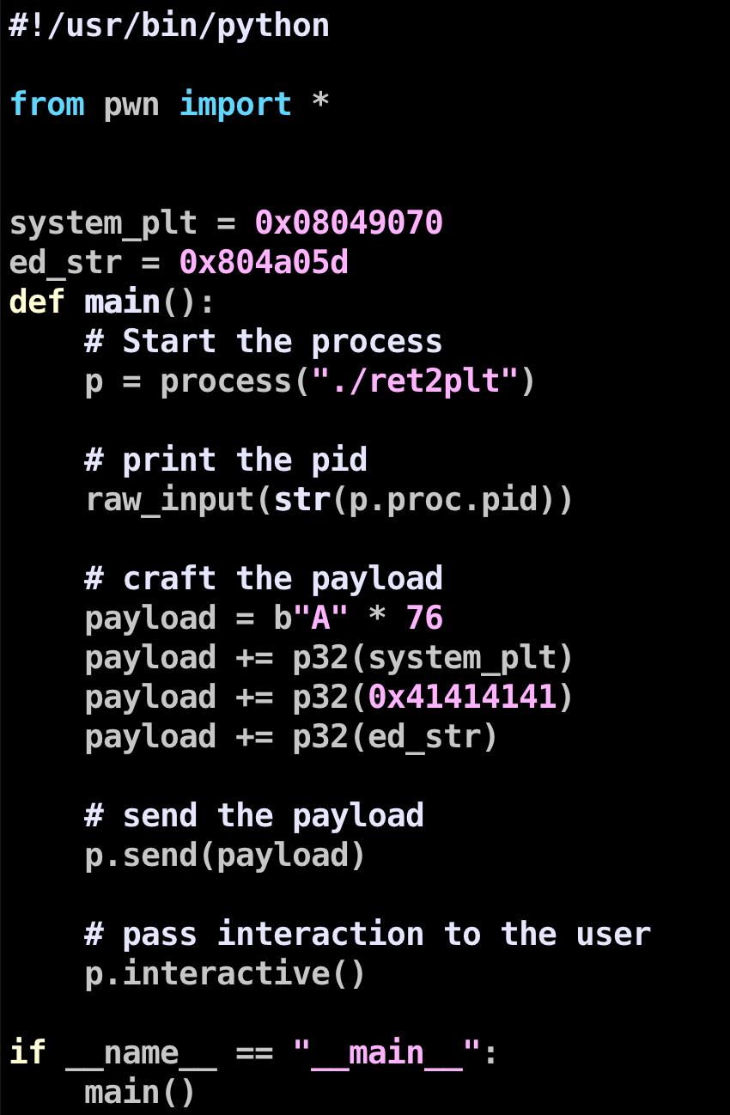
Pwn Script

Slide 34
Hands-on: ret2plt on WolfCTF
One-click browser terminal — ret2plt built -no-pie, NX on, ASLR ON.
Return into system@plt to call system("...") using the binary’s own fixed PLT.
No libc base and no leak needed — the PLT/GOT stubs do not move.
Steps: find the offset → read system@plt (objdump -d) → pick a usable string arg → send the frame.
Demo: portal.wolfctf.com/labs/csc472-ret2plt-demo

Slide 35
Q & A

