Slide 1

Class 15
CSC 472 Software Security
Multi-Stage Exploits
Dr. Si Chen (schen@wcupa.edu)

Slide 2
Review
Where ret2plt, ret2got, and the GOT left us (Classes 12–14)

Slide 3
Recall: calling a libc function through PLT + GOT
puts@plt — a tiny stub in the (fixed, no-PIE) binary that jumps through the GOT
puts@got — a writable slot holding puts()'s REAL runtime address once resolved
puts@libc — the real function, inside libc — whose base ASLR randomizes every run
ret2plt / ret2got — reuse the stub; the leak reads the GOT to locate libc

Slide 4
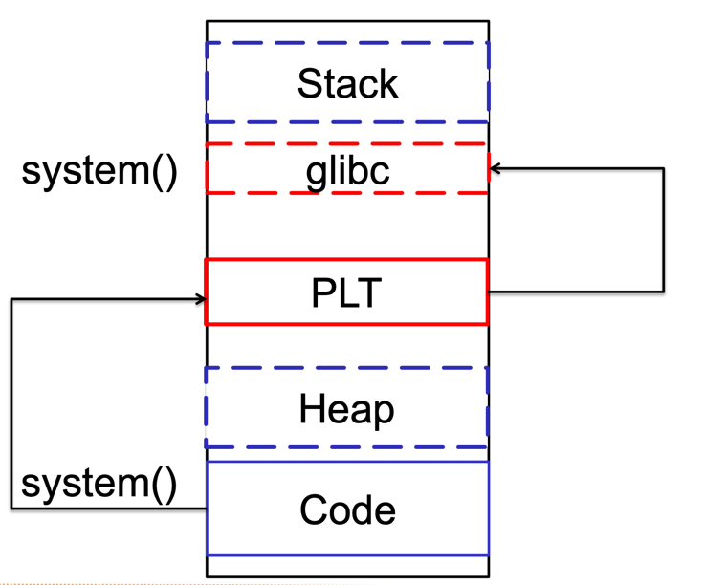
Procedure Linkage Table (PLT)
How does it work?
“call system” is actually call system@plt
The PLT resolves system@libc at runtime
The PLT stores system@libc in system@got

Slide 5
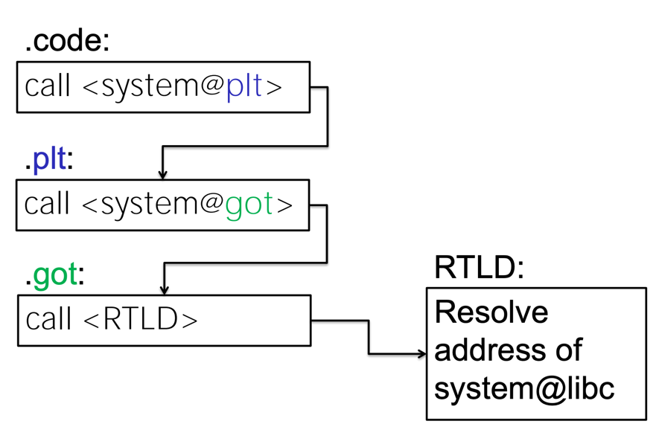
Call System() Function in libc with PLT, GOT

Slide 6
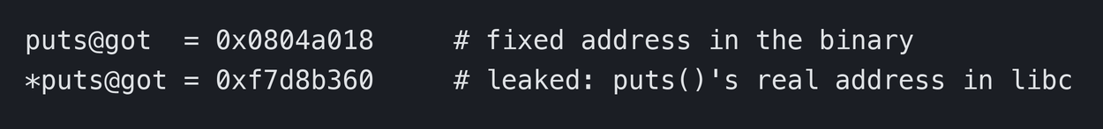
Information leak: read libc’s address out of the GOT
The bug we abuse — the program prints memory — printf("%s", puts@got) or write(1, puts@got, 4)
What comes back — the 4 bytes at puts@got = the live address of puts() in libc
Why it matters — the GOT slot sits at a FIXED no-PIE address and reveals where libc landed
leak

Slide 7
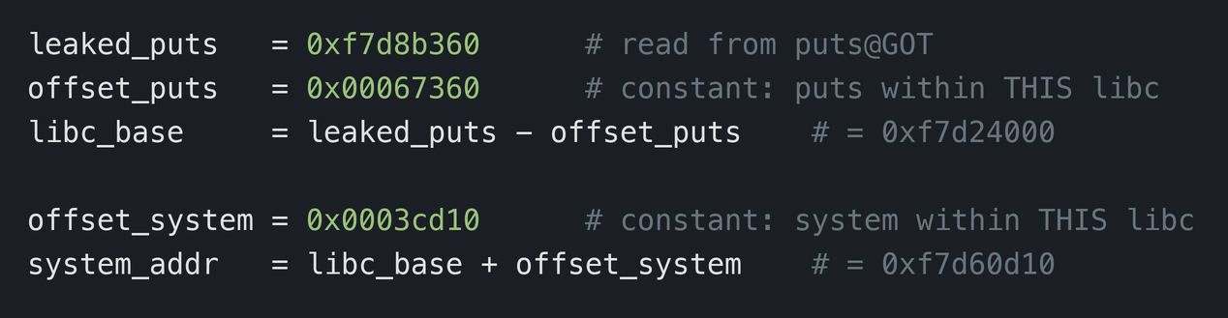
From one leak to every libc address
one leaked function + the libc’s fixed internal offsets → system(), read(), write(), everything

Slide 8
GOT overwrite: redirect a function to system()
Idea — the GOT is writable (Partial RELRO) — overwrite a function’s slot with system()’s address
Effect — the next call to that function is really a call to system() — with the same arguments
Example — overwrite puts@GOT with &system, then puts("/bin/sh") executes system("/bin/sh")

Slide 9
Multi-Stage Exploit
multi_stage.c — one process, ASLR + NX both ON

Slide 10
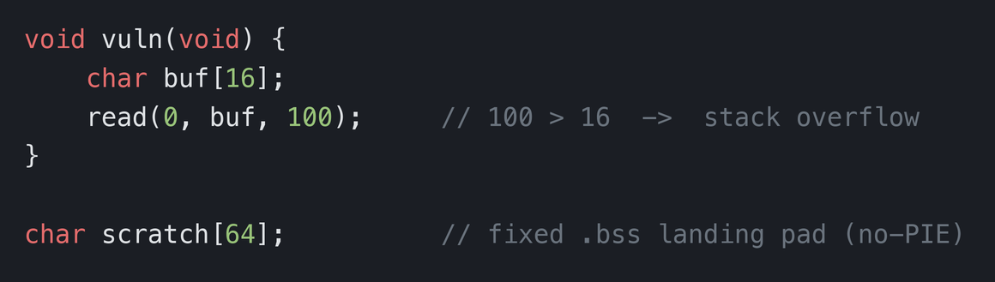
The target: multi_stage.c
Mitigations ON — ASLR (libc moved) and NX/DEP (no injected code) — both enabled
Tiny & -no-PIE — PLT, GOT and .bss sit at FIXED addresses; only libc is randomized
What we get — the binary imports only read() and write(), plus the gadgets ROPgadget finds
multi_stage.c (essence)

Slide 11
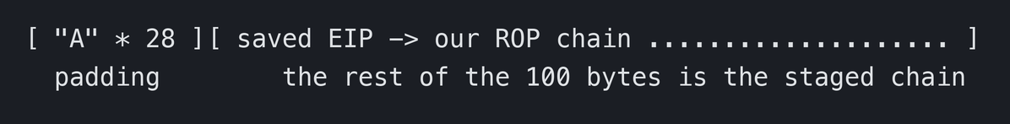
Stage 0: buffer overflow, take EIP
Overflow — read(0, buf, 100) runs past the 16-byte buffer into the saved return address
Find the offset — De Bruijn pattern → read EIP in gdb → cyclic_find(); here it is 28 bytes
Constraint — the WHOLE ROP chain must fit in the 100 bytes read() accepts — 100 = 28 + 72
layout of the overflow

Slide 12
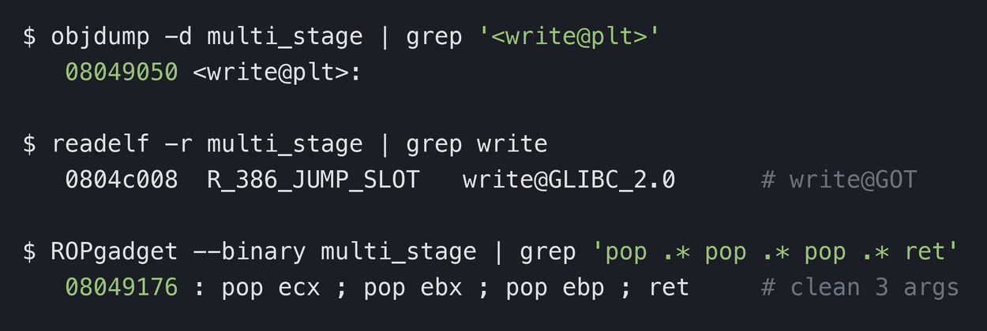
Find the fixed pieces: objdump + readelf
recon — all FIXED, because the binary is -no-pie

Slide 13
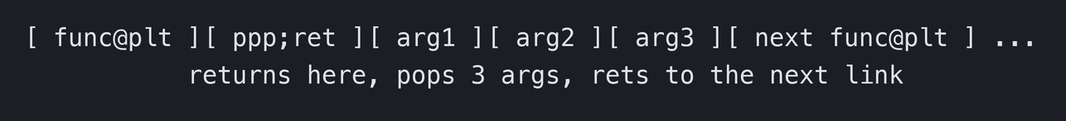
ROP chaining needs to clean the stack
Problem — cdecl leaves each call’s 3 arguments on the stack; the next ‘return’ lands in them
Fix — return into a pop; pop; pop; ret gadget — it drops the 3 args and rets to the next link
one link, generalized

Slide 14
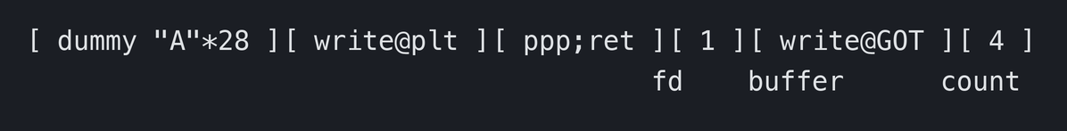
Stage 1: leak the libc base
ROP — write(1, write@GOT, 4) prints write()’s real libc address
Then — libc_base = leaked_write − offset(write); every libc symbol follows
Stay alive — each stage returns into main(), so the process — and its libc base — survives
the stage-1 link (cdecl: args on the stack)

Slide 15
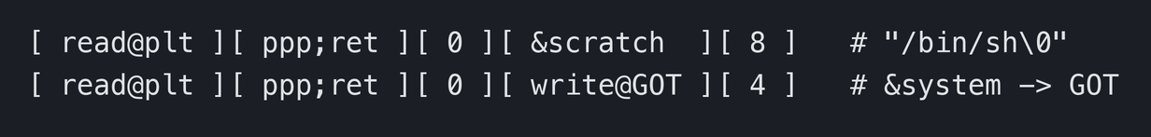
Stage 2: GOT overwrite (read into write@GOT)
ROP — read(0, write@GOT, 4) reads 4 attacker bytes straight into write’s GOT slot
We send — &system (from the stage-1 leak) — now write@GOT points at system()
Also — a second read drops "/bin/sh\0" into the fixed .bss buffer scratch
stage-2 links

Slide 16
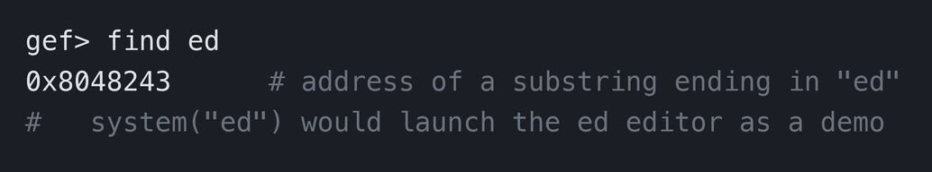
Where does the command string come from?
No "/bin/sh" in the binary — so we supply one at a known, fixed address
Our approach — read() "/bin/sh\0" into scratch[] — a .bss global, fixed because -no-pie
ss2024 alternative — gdb’s find locates an existing string (e.g. "ed") → system("ed")
find a string in memory (the slides’ way)

Slide 17
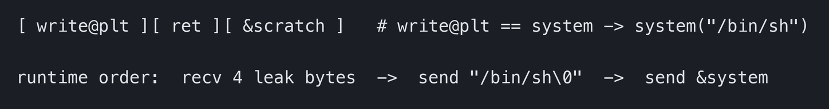
Stage 3: spawn the shell
write@GOT now = system — the PLT stub jmp *write@GOT jumps into system()
So — calling write@plt(&scratch) is really system("/bin/sh")
Result — a shell — with ASLR and NX still on the whole time
stage-3 link

Slide 18
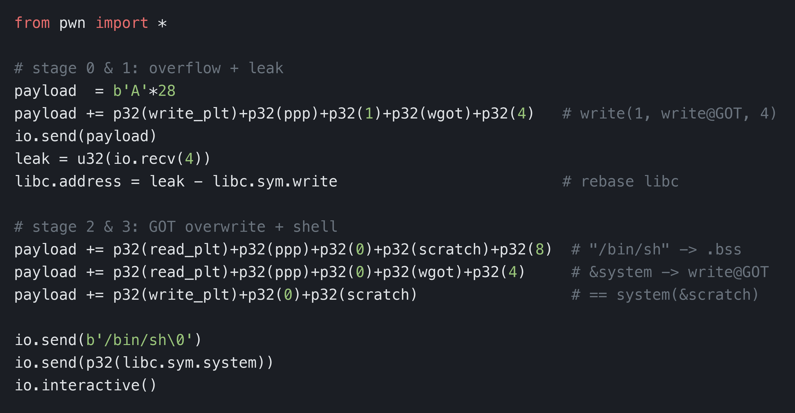
The pwn script (multi_stage.py)
full working script ships in the Week 10 code

Slide 19
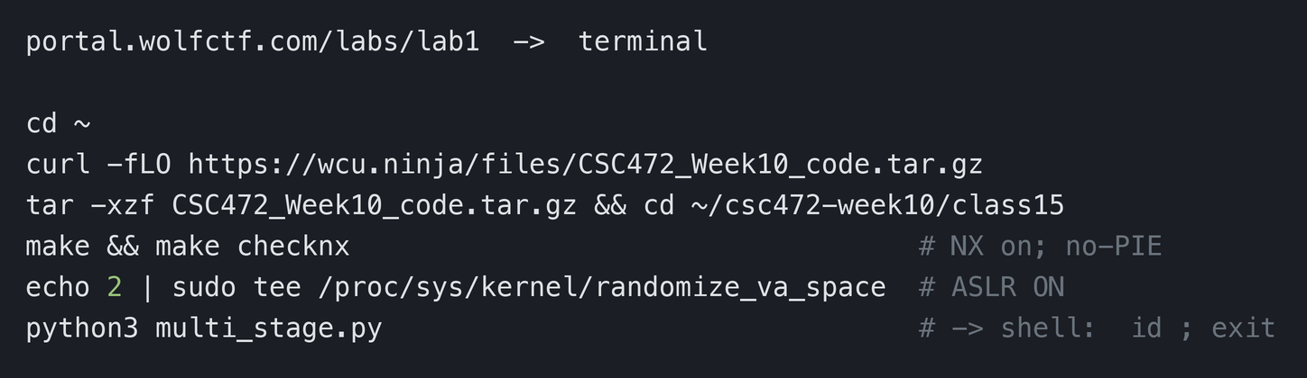
Run it in the WolfCTF lab
course use only — run only the included binary in your own lab terminal

Slide 20
DEP & ASLR: the two pillars we just bypassed
NX / DEP — stops injected shellcode — so we reused existing code (ret2plt + ROP)
ASLR — hides libc’s base — so we forced an information leak first
Takeaway — chaining a leak with a GOT overwrite under both is real-world exploitation

Slide 21
What made the GOT reachable: no PIE
PIE — Position Independent Executable — shared libs (libc) MUST be built this way
Build with — -pie -fPIE; without them the executable loads at a fixed base ASLR cannot move
Our target is -no-pie — so PLT/GOT/.bss are fixed — exactly what leak and overwrite relied on
History — ~2015 most system binaries were NOT PIE; by 2018 nearly all are

Slide 22
Defense in depth: no single layer is enough
NX/DEP — forces code reuse instead of injected shellcode
ASLR + PIE — forces an info leak and moves the binary too, not just libc
Full RELRO / BIND_NOW — remaps the GOT read-only — kills stage 2 (GOT overwrite)
Stack canary — catches the overflow before the return (next class)
Don’t write the bug — bounded reads instead of read(0, buf[16], 100); memory-safe languages

Slide 23
Q & A
Next: Class 16 — StackGuard & Format String Bug

