Slide 1

Class 16
CSC 472 Software Security
StackGuard & Format String
Dr. Si Chen (schen@wcupa.edu)

Slide 2
Binary protection mechanisms
NX / DEP — mark the stack non-executable — injected shellcode cannot run
ASLR — randomize the address space — libc and (with PIE) the binary move each run
StackGuard (stack canary) — detect a stack overflow BEFORE the saved return address is used — today’s first topic

Slide 3
StackGuard
Cowan et al., USENIX Security 1998 — a.k.a. stack canaries / cookies

Slide 4
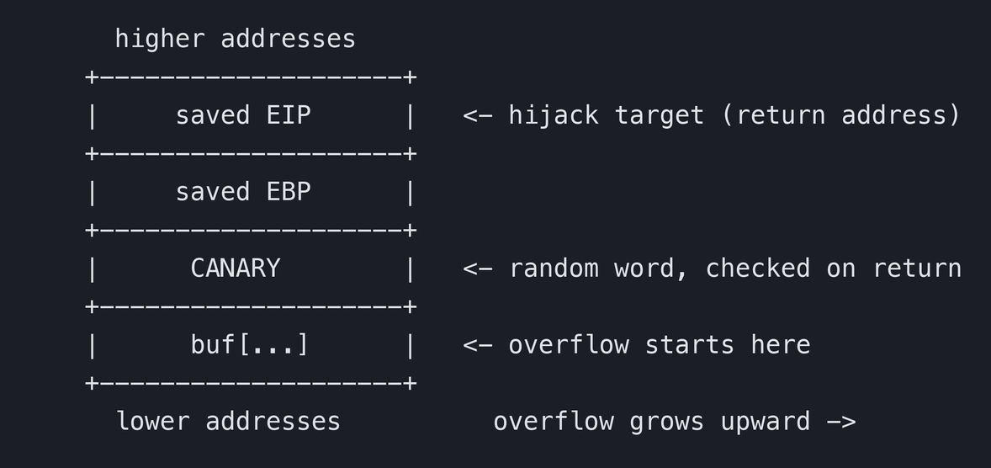
What a stack canary does
Insert — the compiler places a random integer between the local buffers and the saved return address
Check — on function return, verify the canary is unchanged
If smashed — the overflow hits the canary first → check fails → __stack_chk_fail aborts before EIP is used
the stack frame

Slide 5
Why “canary”?
Canaries were carried into coal mines to detect carbon monoxide. The bird’s fast metabolism meant it collapsed before the miners — an early warning that bought time to escape.
A stack canary is the same idea: it “dies” (changes value) from an overflow before the damage — a hijacked return — can be used.

Slide 6
A short history of canary values
1998 — hardcoded — the first canary was a constant, 0xDEADBEEF
Terminator canary — bytes CR, LF, 0x00, 0xFF — stop string functions (strcpy) copying past them
Random canary — a fresh value from /dev/random per run (glibc: low byte is 0x00)
XOR random canary — canary XOR-ed with the saved return address — catches some partial overwrites too

Slide 7
Canary drawbacks
Overhead — a check on every protected function (cache footprint)
Stack only — defends stack overflows — not heap corruption, not GOT / format-string writes
NULL canaries — a null-byte canary can sometimes be abused
Random canaries — can be learned — leaked (format string) or brute-forced (forking server)

Slide 8
Bypassing StackGuard
If you cannot avoid the canary, learn it

Slide 9
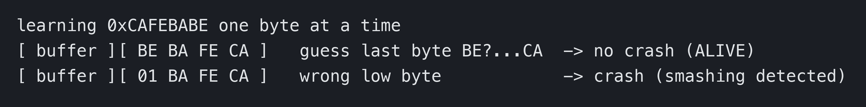
Brute-force stack reading
Byte by byte — overwrite exactly one more canary byte and guess its value (0x00–0xFF)
Oracle — no crash → correct byte; crash (stack smashing detected) → wrong guess
Cost — 256 guesses × 4 bytes ≈ 1024 tries (x86-32)
Requirement — the SAME canary must persist — so the target must fork, not execve()
brute-forcing the canary

Slide 10
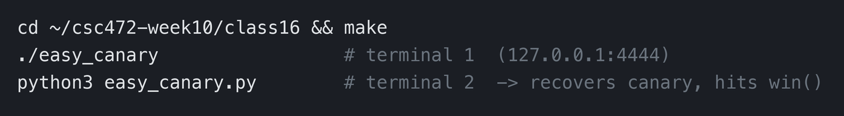
Demo: easy_canary (forking server)
Why it works — fork() copies the parent, canary and all — every child shares ONE canary
Recover it — brute each byte until the child answers ALIVE (canary check passed)
Then — overflow past the known canary (sent back unchanged) to the return address → win()
in the lab

Slide 11
Format String Bug
When printf() trusts attacker input

Slide 12
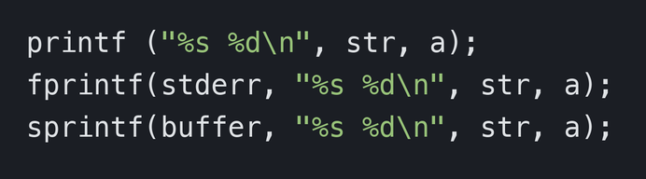
What is a format string?
A format string is ASCII text plus format parameters that tell printf() how many arguments to read and how to print them. printf relies on the FORMAT to know what was pushed — control the format and you control that contract.
the printf family

Slide 13
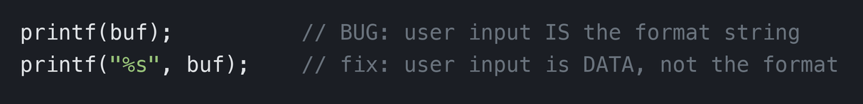
The bug: the wrong way to print
If we control buf — we can name arguments that were never passed
printf obliges — it walks up the stack reading whatever is there
wrong vs right

Slide 14
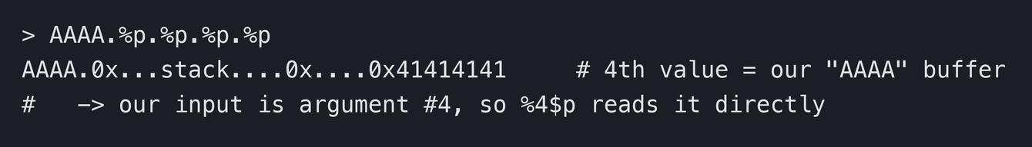
Example: fmt_wrong.c — reading the stack
Send — a marker then many specifiers: AAAA %p %p %p %p ...
Watch for 41414141 — that is our own "AAAA" on the stack — its position is OUR argument index
Here — our input is argument #4, so %4$p reads it directly
leak

Slide 15
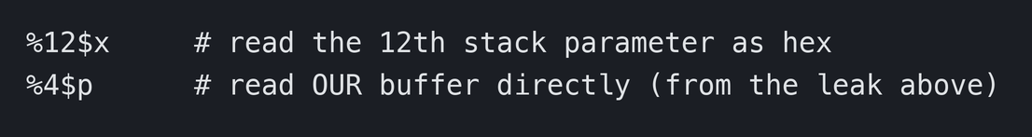
Direct parameter access
Instead of walking 1..N with repeated specifiers, the dollar qualifier jumps straight to the Nth stack parameter. This index is the key to a controlled %n write — it tells printf which stack slot holds the address we placed.
direct access

Slide 16
What the bug is used for
Read any address — %s treats a stack dword as a char* and prints the string there
Write any address — %n stores the number of characters printed so far into a pointer argument
No overflow needed — format-string read/write is a primitive on its own — canaries do not stop it

Slide 17
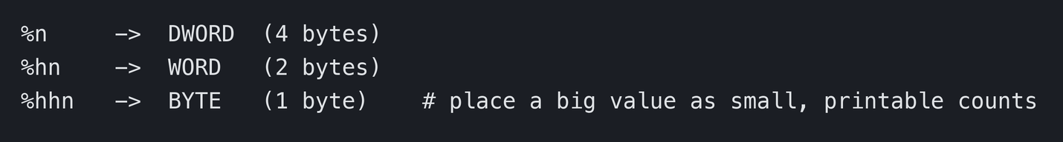
fmt_write.c: the %n arbitrary write
%n writes *(int*)arg = (characters printed so far). Aim it at a chosen address and control the count → write-what-where.
widths

Slide 18
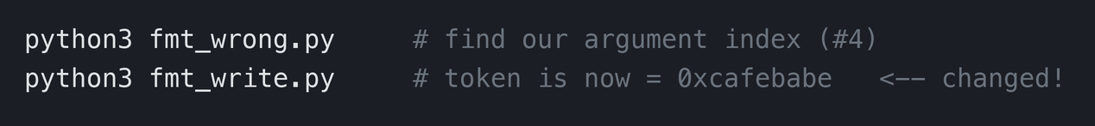
Example: flip token 0xdeadbeef → 0xcafebabe
Target — a global token; the binary is -no-pie, so &token is fixed
Find it — nm fmt_write | grep token (or make token)
Write it — pwntools fmtstr_payload builds the %...c/%n string — no overflow at all
in the lab

Slide 19
The real power: defeating the other mitigations
Disclose variables / saved EBP — locate the stack and where to place a payload
Disclose the StackGuard canary — leak it with %s/%x — bypass the stack check with no brute force
Disclose a libc address under ASLR — leak one function’s runtime address → deduce the rest by fixed offsets
That last one — is exactly the information leak Class 15 depended on

Slide 20
The fix, and defense in depth
One rule — user data is never the format string: printf("%s", buf), not printf(buf)
Compiler help — -Wformat -Wformat-security flags printf(buf) at build time
Canary — raises the cost of a stack overflow — but a leak or a forking server can still beat it
Layers together — NX, ASLR/PIE, Full RELRO, canaries, and not writing the bug — no single one is enough

Slide 21
Q & A
Next: Week 11 — Heap overflow and heap-oriented vulnerabilities

