Slide 1
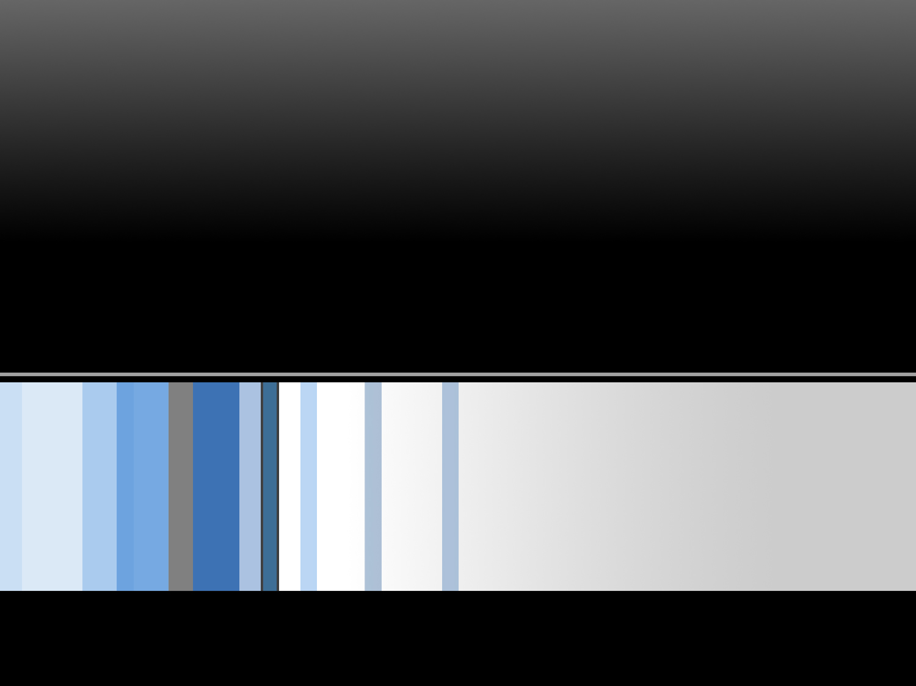
Special Topic
SPECIAL TOPIC · LIVE VULNERABILITY
PHP2Shell
CVE-2026-109618 & CVE-2026-109619
The bug you already know how to exploit — this time in the runtime
behind a fifth of the web
CSC 472 Software Security · Dr. Si Chen (schen@wcupa.edu)
Notes:
Framing (1 min). This is a bonus topic, not a numbered class — we're doing it now because it's live and it's a perfect mirror of what we study. By the end you should be able to say, in one sentence, why a memory bug in PHP let an unauthenticated attacker run shell commands, and point to where we've seen that same bug before. Don't memorize symbol names; follow the STORY.

Slide 2

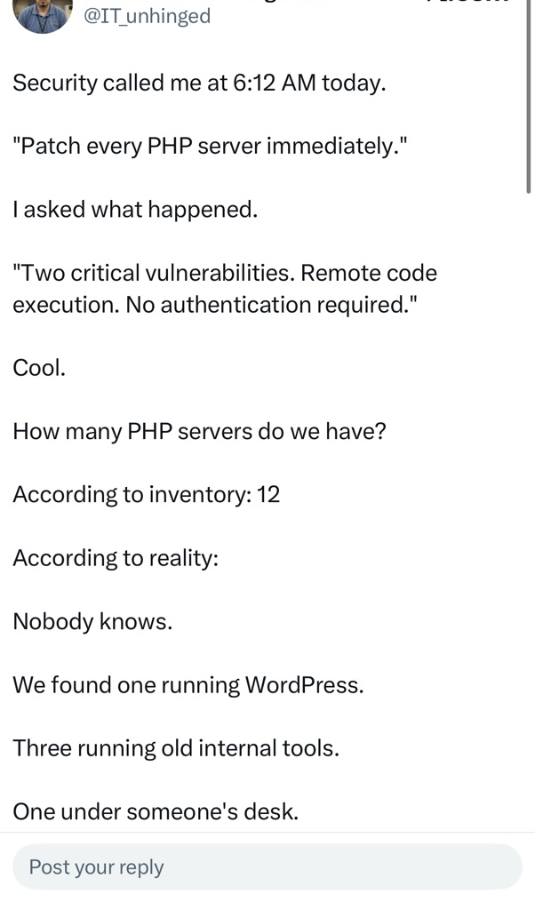
It started with a 6 a.m. phone call
October 21, 2026.
“Patch every PHP server. Now. Two critical RCEs, no authentication.”
Then the real question:
How many PHP servers do we even have?
Inventory said 12.
Reality: nobody knew. One was running WordPress. Three were old internal tools. One was
under someone’s desk.
@IT_unhinged · the sysadmin reality
1
Notes:
Hook (2 min). Read the tweet out loud — it gets a laugh, and the laugh IS the lesson. Ask the room: 'If you ran IT for this company, what do you do at 6 a.m.?' Let them answer. Land the point: the technical bug is only half the story — the other half is that nobody has an accurate inventory of what they're running. Hold that thought; we come back to it at the end. Today we answer: what was so bad that security called at dawn?

Slide 3
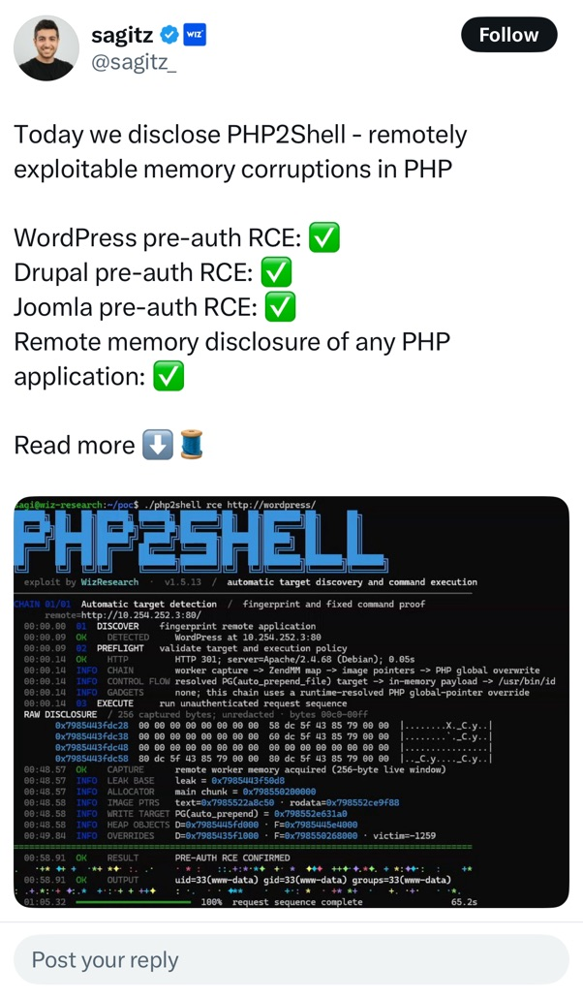
This is the tool that caused the panic
One HTTP request.
No login. A shell.
The researchers’ tool auto-targets the big PHP apps:
WordPress ✓
Drupal ✓
Joomla ✓
+ remote memory disclosure of any PHP app.
Look at the terminal → “PRE-AUTH RCE CONFIRMED · uid=33(www-data)”
@sagitz_ · Wiz Research — the disclosure
2
Notes:
The stakes (2 min). Point at the terminal screenshot. Walk the timeline it prints: discover the app, fingerprint PHP, resolve a memory pointer, dump a 256-byte live window of server memory, then confirm RCE as www-data. Emphasize PRE-AUTH — the attacker never logged in. Ask: 'Why would a bug in WordPress AND Drupal AND Joomla all at once?' Answer: it isn't in any of them — it's in PHP itself, underneath all of them. That's why one bug threatens millions of sites.

Slide 4
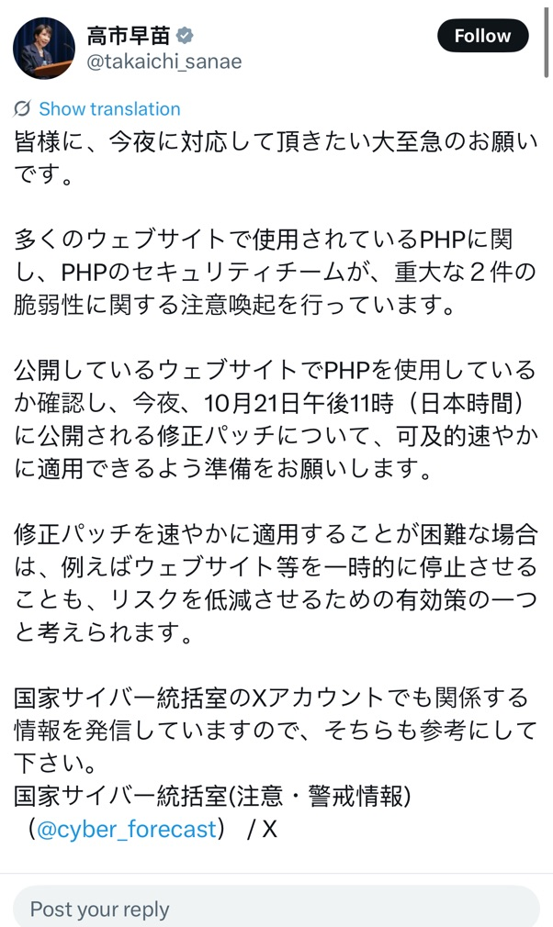
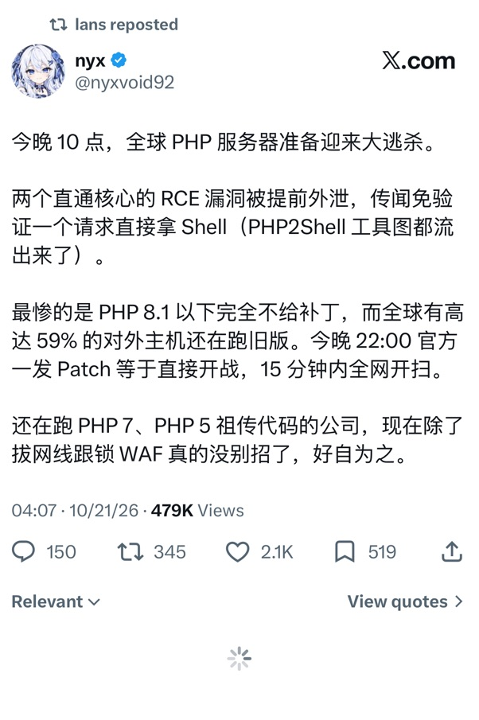
Governments told people to pull the plug
Japan, national advisory:
“Check if your public sites use PHP. Apply tonight’s 11 PM patch ASAP. If you can’t, taking the site offline is a valid way to cut risk.”
The street view:
“PHP ≤ 8.1 gets NO patch. ~59% of public hosts still run old versions. When the patch drops, the whole net gets scanned in 15 minutes.”
@takaichi_sanae · Japan (translated)
@nyxvoid92 · the panic (translated)
3
Notes:
Scale (2 min). When a national cyber office tells businesses to consider taking sites OFFLINE, that is not routine. ~22.6 million exposed instances. The releasing of a patch is itself the starting gun — attackers diff the patch to build the exploit, so publishing the fix tells everyone exactly where the bug is. Ask: 'Why does patching make it MORE dangerous short-term?' (patch-diffing). Transition: so — why is the whole internet on fire over a MEMORY bug? That's our world. Let's open it up.

Slide 5
You have already exploited this exact bug
Everything in PHP2Shell is a bug class from THIS course — just in a huge target.
Lab 1–2
Overflow a buffer, corrupt memory you shouldn’t reach
Class 12–14
Leak an address to beat ASLR; reuse libc / PLT–GOT for code exec
Week 11
Use-after-free + heap grooming to land attacker bytes in a freed slot
PHP2Shell = all three, chained, against a server that never restarts.
Notes:
The pivot (2 min). This is the emotional turn of the lecture — make eye contact. Tell them: you are not spectators to this news; you already own the toolkit. Go row by row and have THEM finish each sentence ('in Lab 1 we... overflowed a buffer'). The only genuinely new ingredient is the last line: the server never restarts between requests. Everything after this slide explains how that one fact turns familiar bugs into a remote catastrophe.

Slide 6
The one new idea: the server never forgets
Our lab binaries start fresh and exit. A PHP worker is long-lived — it serves request after request, and is supposed to wipe its state between them.
ONE WORKER PROCESS — survives across requests
Request A
(attacker)
breaks something
Request B
state NOT
fully wiped
Request C
trips over
the leftover
Remember two words for the rest of today:
Producer — the request that leaves broken state behind. Consumer — a later request that uses it.
4
Notes:
Core concept (3 min). Draw this on the board too if you can. The whole lecture hinges on it. Analogy: a hotel room cleaned between guests vs. a room where the last guest left something dangerous and housekeeping skipped a spot. 'Producer' and 'Consumer' are the only vocabulary they must keep. Ask: 'In our labs, could a bug in one run affect the next run?' (No — process exits.) 'Here?' (Yes — same worker.) That difference is the entire attack surface.

Slide 7
Both bugs share one villain: how PHP gives up
When PHP runs out of memory, it doesn’t clean up on the way out. It jumps.
What SHOULD happen
What actually happens
Finish the operation → tidy up each half-done thing → reset globals → end request cleanly.
zend_bailout() = longjmp()
a jump across functions, straight to shutdown — skipping all the tidy-up.
That “goto” leaves two kinds of wreckage — one bug each:
109618 a half-built object the cleanup still trusts 109619 a pointer to memory that’s already freed
5
Notes:
The 'aha' (2 min). This is the single technical insight that unlocks both CVEs, so slow down. longjmp is literally C's goto-across-functions — it was MEANT as a safe way to abort a request, but it bypasses the careful cleanup code. Analogy: pulling the fire alarm and sprinting out the building mid-surgery — you escaped, but you left the patient open. Now we look at the two specific messes it leaves. Don't drown them in detail; two bugs, two kinds of wreckage.

Slide 8
Bug #1 — the half-built object (CVE-2026-109618)
1
Start building
PHP marks “slot #5 exists” before it has finished writing slot #5.
2
Run out of memory
The allocation for slot #5 fails — longjmp aborts. But the count already says it’s there.
3
Cleanup trusts the count
Shutdown reads slot #5 as a real object and follows its (garbage) pointer.
With heap grooming (Week 11!), the attacker owns those garbage bytes → code execution.
Reaching “out of memory”: a crafted multipart upload inflates internal structures without tripping upload limits — under post_max_size, still over memory_limit. Path dates to PHP 5.4 (2012).
6
Notes:
Bug 1 (4 min). Tell it as a story with the 'slot #5' metaphor — a to-do list where you write 'item 5: done' before actually doing item 5, then faint. Someone later reads the list and acts on item 5. Beat 1-2-3, pause after each. Only after the mechanism is clear, mention the heap-grooming escalation (callback to Week 11) and the multipart trick to force OOM. Note it's a 13-year-old code path — these bugs hide for a long time. Ask: 'Where have we trusted a length/count that didn't match reality?' (string overflows).

Slide 9
Bug #2 — the ghost pointer (CVE-2026-109619)
A global still points at memory that was already freed. The next request follows it.
PRODUCER
heap
FREED
but the global
still points here
CONSUMER
Request hits a fatal error (OOM, timeout, failed require…). longjmp aborts before the global is reset.
A later request touches that global before init resets it — attacker now controls freed memory. Use-after-free.
The sneaky part: the “consumer” can be a mere warning message. Hiding it with @ or display_errors=Off doesn’t help — generating the warning is what touches the dead pointer.
Default trigger: session upload-progress runs this path before your app code does — no session_start() needed. (Confirmed RCE case on PHP 8.5 via the fatal-error backtrace global.)
7
Notes:
Bug 2 (4 min). This is the textbook use-after-free from Week 11 — name that explicitly. Walk producer -> freed heap -> consumer left to right. The counterintuitive teaching moment: a suppressed warning STILL triggers it, because PHP has to build the warning (touching the dead pointer) before deciding whether to show it. Students always assume @/error_reporting=0 is safe — break that assumption. Mention upload-progress is on by default and runs before app code, so 'my app doesn't use sessions' is no defense.

Slide 10
The payoff: read server memory from a cookie
You don’t need full RCE to see the danger — just a read primitive, exactly like our GOT leak to beat ASLR.
1
Prime A multipart upload makes a session pointer point into the request heap.
2
Free Force OOM — longjmp aborts, the heap is freed, the pointer dangles.
3
Reuse Send a second upload to the same worker; cleanup runs before reset.
4
Leak PHP trusts the dead pointer and writes those bytes into your cookie.
HTTP/1.1 200 OK
Set-Cookie: PHPSESSID=%00%7f%45%4c%46%02%01%01...
↑ raw bytes of freed server memory, handed to the attacker
Same move as Class 14: leak first, then aim. Chain this read into the Bug #1 write and you have pre-auth RCE.
8
Notes:
Payoff (3 min). This is where it clicks. We don't need to weaponize live in class — the leak alone proves the point and it's the SAME shape as the GOT/puts leak we used to defeat ASLR in Class 14. Walk the 4 steps, then show the cookie: those %-encoded bytes are literally RAM from the server process (note the ELF header \x7fELF — that's a binary mapped in memory). Ask: 'What would you look for in that leaked memory?' (pointers to defeat ASLR, secrets, session tokens). Then the chain: leak to aim, Bug #1 to write = RCE.

Slide 11
How they fixed it — and what you’d tell a client
The real fix
If you can’t patch tonight
Stop jumping. OOM no longer calls longjmp mid-operation — it waits for a safe point, or exits hard.
Wipe the room. Shutdown now resets the full set of request-owned globals before freeing the heap.
• memory_limit = -1 (admin-enforced)
• session.upload_progress.enabled = 0
• fatal_error_backtraces = 0 (8.5)
• bound request size at the proxy; restart workers
Stopgaps only — other variants may exist.
Update is the only complete fix:
8.2.35
8.3.36
8.4.27
8.5.12
PHP 8.1 and older are end-of-life — no official patch. If you’re on them, you’re on your own.
9
Notes:
The fix (2 min). Tie it back: the bug was the ABORT path, not a feature — so the fix fixes how PHP gives up (no more mid-operation longjmp) and makes cleanup thorough. Frame the right column as 'you're the consultant at 6 a.m. — what do you tell them?': patch if you can; if not, these knobs buy time; and ending EOL versions is a business decision, not a technical one. Callback to slide 2: the hardest part isn't the patch, it's finding all 12-plus servers.

Slide 12
What to take away
Memory bugs scale. The classes you practice on tiny binaries are what put 22M servers at risk.
The abort path is attack surface. “Safe” error handling that skips cleanup is where the bug lived.
Shared state is dangerous. If a process serves many requests, one can poison the next. Reset, never assume.
Talk it through
1. Why is Apache mod_php rated worse than PHP-FPM for the same bug?
2. Why don’t @, display_errors=Off or error_reporting stop Bug #2?
3. We leaked bytes into a cookie — trace the path from that read to full RCE using Class 12–14.
4. Which Week-11 heap skill makes landing attacker bytes in the freed slot easiest?
Notes:
Close + discuss (5 min). Deliver the three takeaways as the thesis of the day, slowly. Then open the floor — these questions are ordered easy-to-hard. Q1 checks the worker model (FPM kills the child on startup failure; mod_php keeps serving). Q2 checks the 'generating the warning touches the pointer' insight. Q3 is the synthesis — let a student walk the whole chain at the board. Q4 previews next unit. End by returning to the 6 a.m. call: the exploit is elegant; the operational chaos is where real orgs lose.

Slide 13
Sources & further reading
PHP official advisory (21 Oct 2026) — php.net/archive/2026.php#2026-10-21-5
GHSA-w8hw-w9fx-j79w — RCE via OOM corruption (CVE-2026-109618)
GHSA-6wmf-4rv5-p3rp — RCE via stale global state (CVE-2026-109619)
Calif.io (LCFR) — original research write-up, calif.io/php2shell
Wiz Research — PHP2Shell technical breakdown (symbols & confirmed cases)
Unit 42 (Palo Alto) — threat brief + 22.6M exposure figure
Tenable / watchTowr / Help Net Security — FAQ, exploitation status, timeline
Reaction posts: @sagitz_, @takaichi_sanae, @nyxvoid92, @IT_unhinged (translated). Credits: Calif.io, Wiz, OpenAI; fixes by arnaud-lb, iluuu1994, bukka, ndossche.
10
Notes:
Point students at Calif.io and Wiz for the deep dive. Remind them the research is a day old — treat specifics as provisional. The slides and this reading list are on the course site under the PHP2Shell special topic.

